Slide 1
Welcome to AWS Presentation

Slide 2
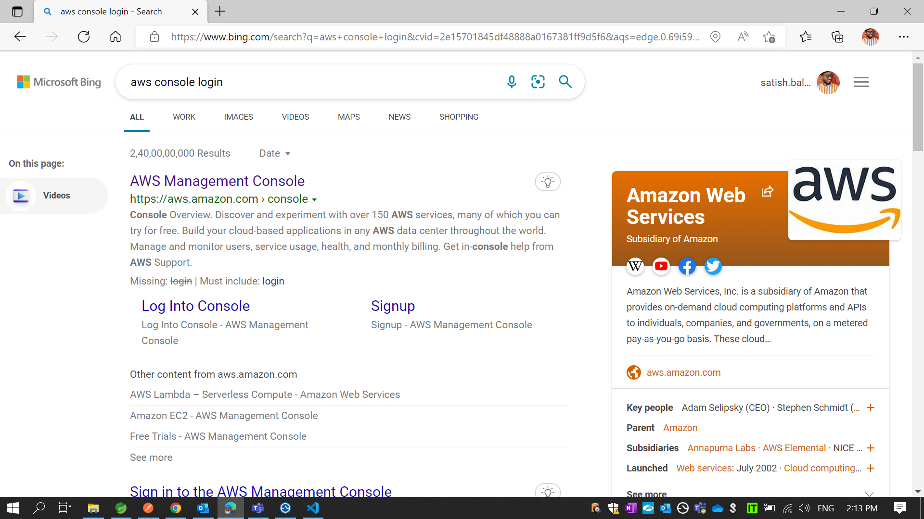
* Open your browser and type AWS console login

Slide 3
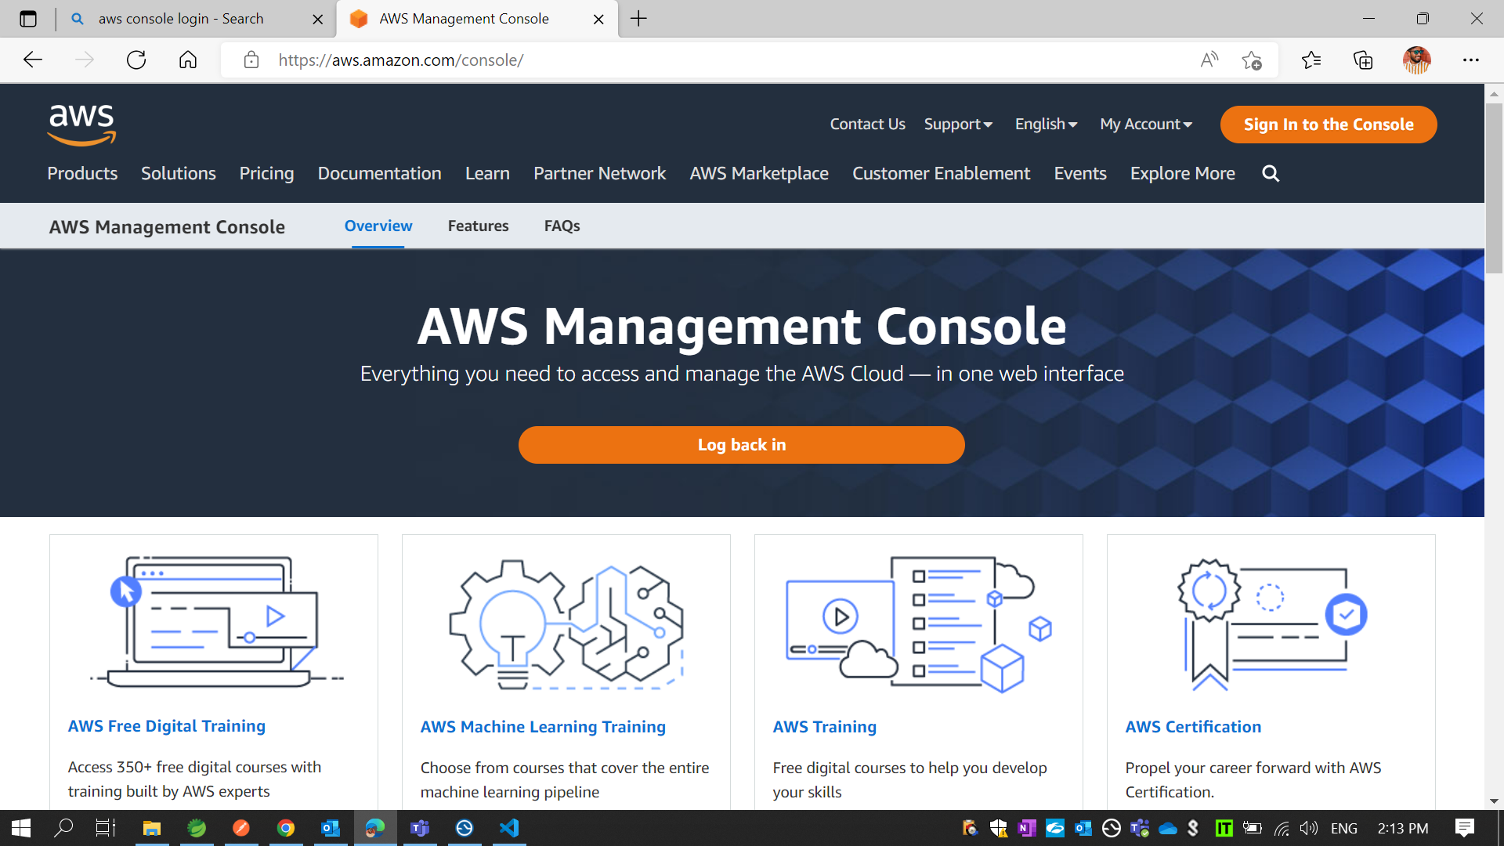
*Click on Sign In the Console

Slide 4
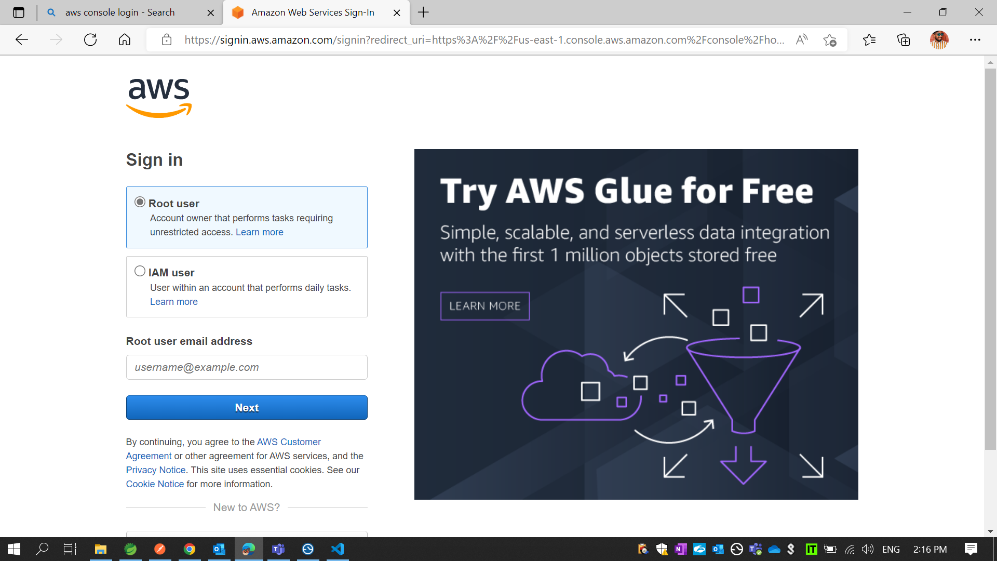
*Enter Root User address

Slide 5
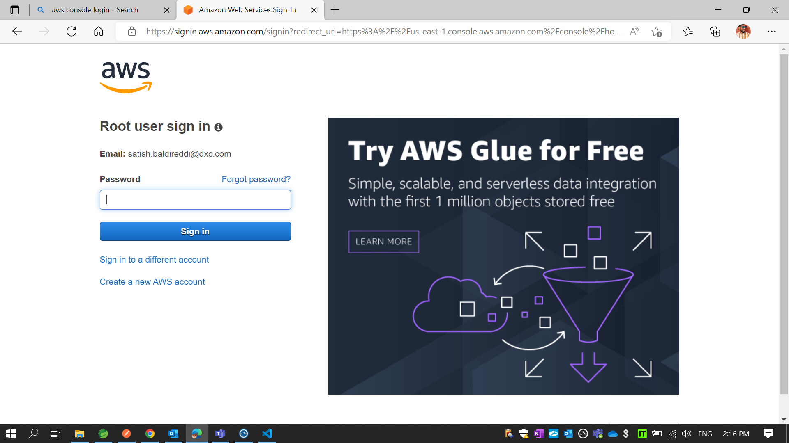
*Enter password

Slide 6
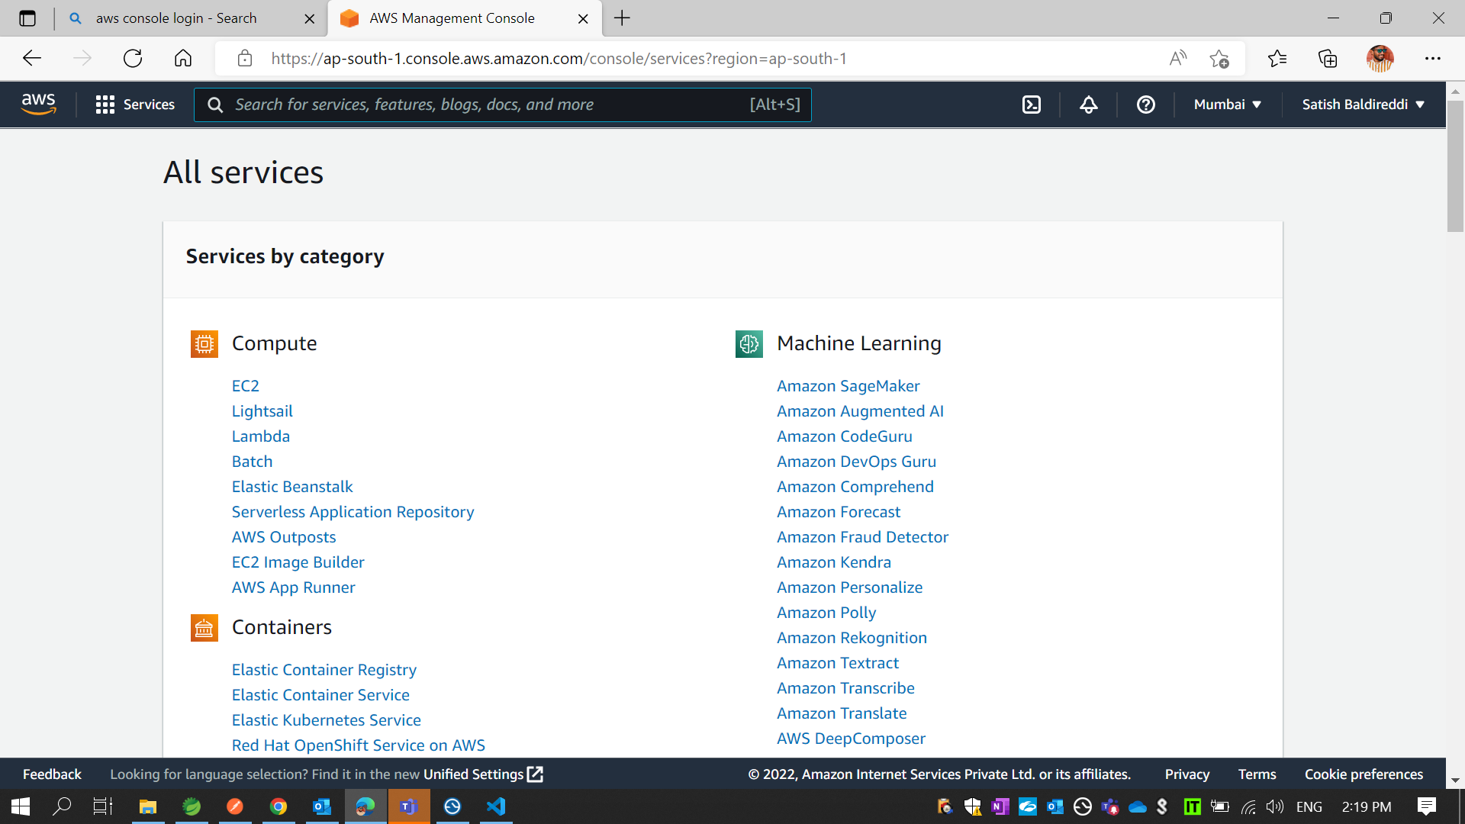
* Then you find All different services available in AWS

Slide 7
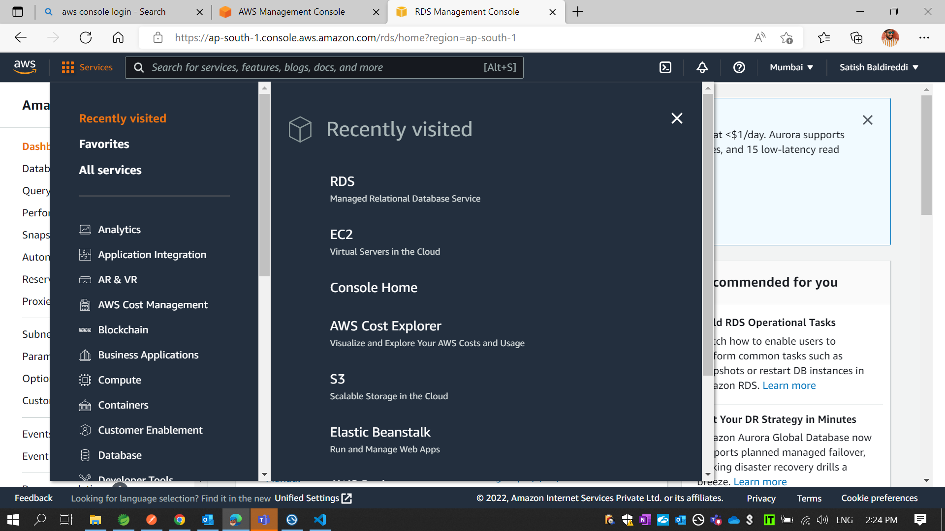
* Clink on RDS

Slide 8
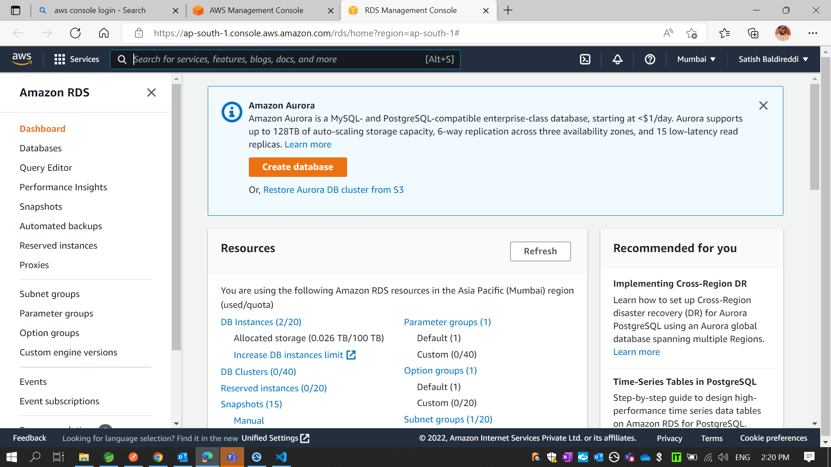
* Clink on Create database

Slide 9
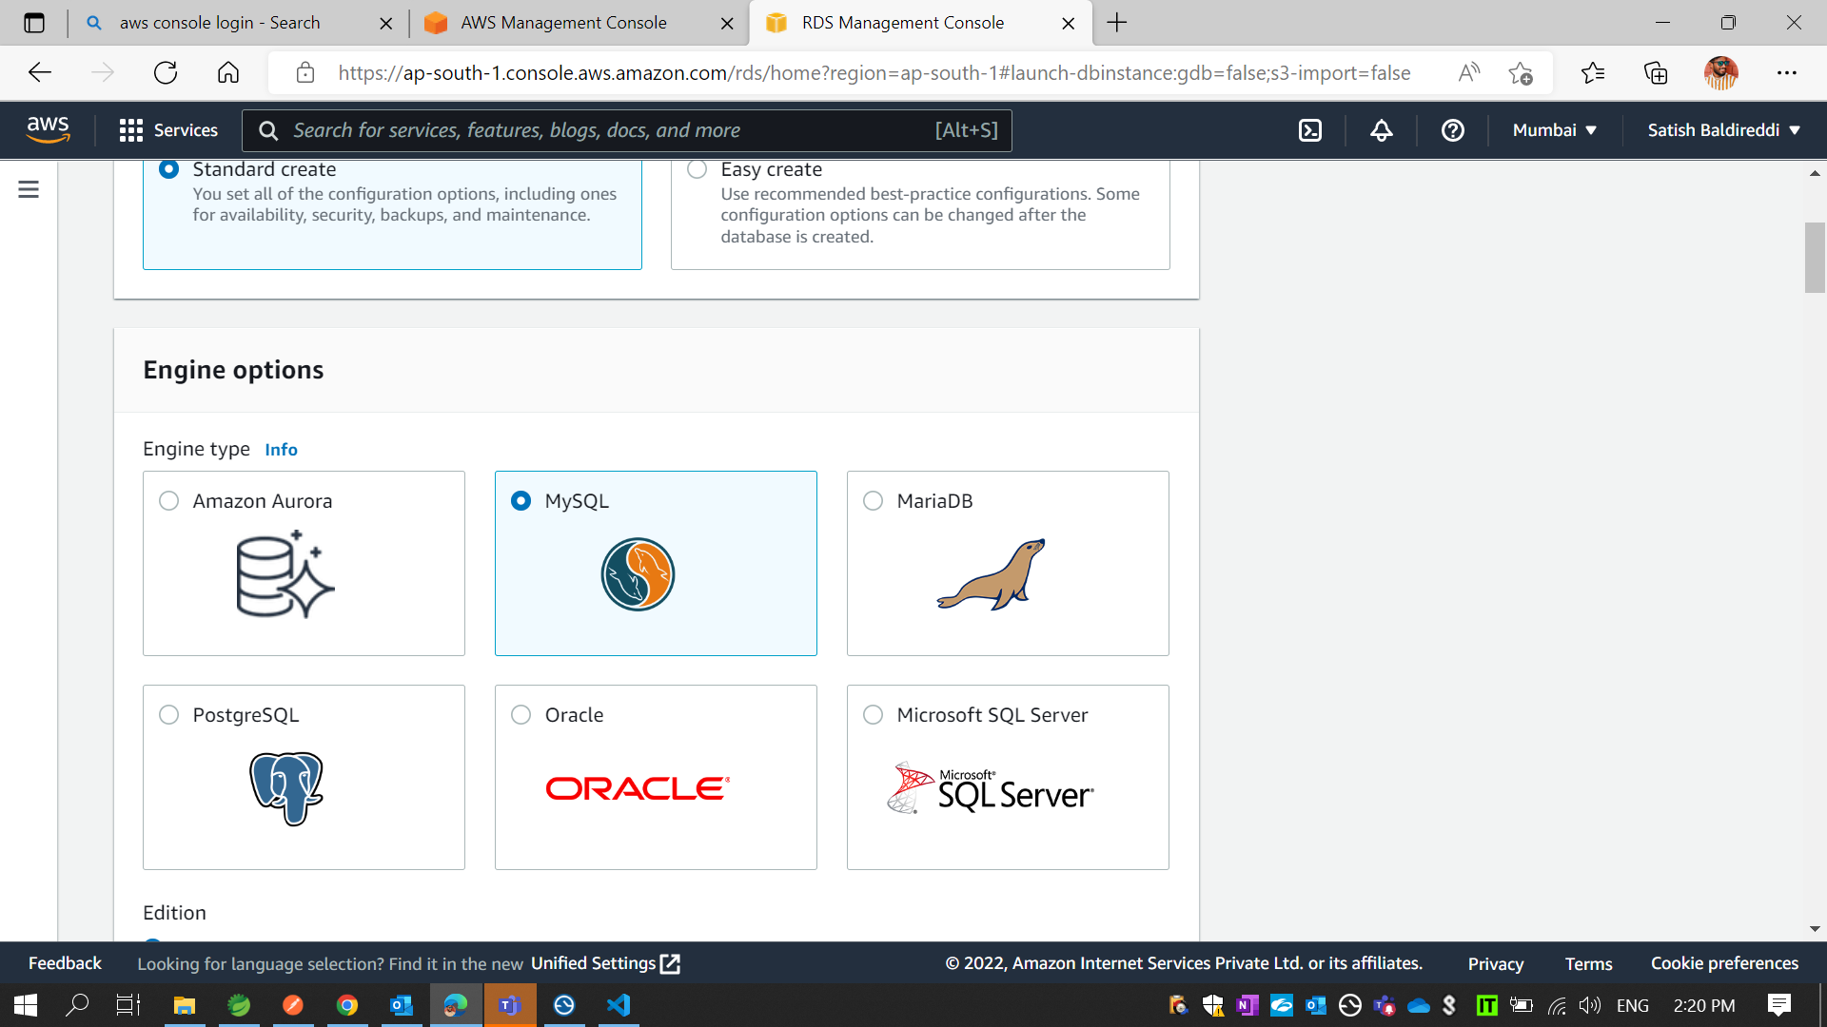
* Select which database you want like “MySql”

Slide 10
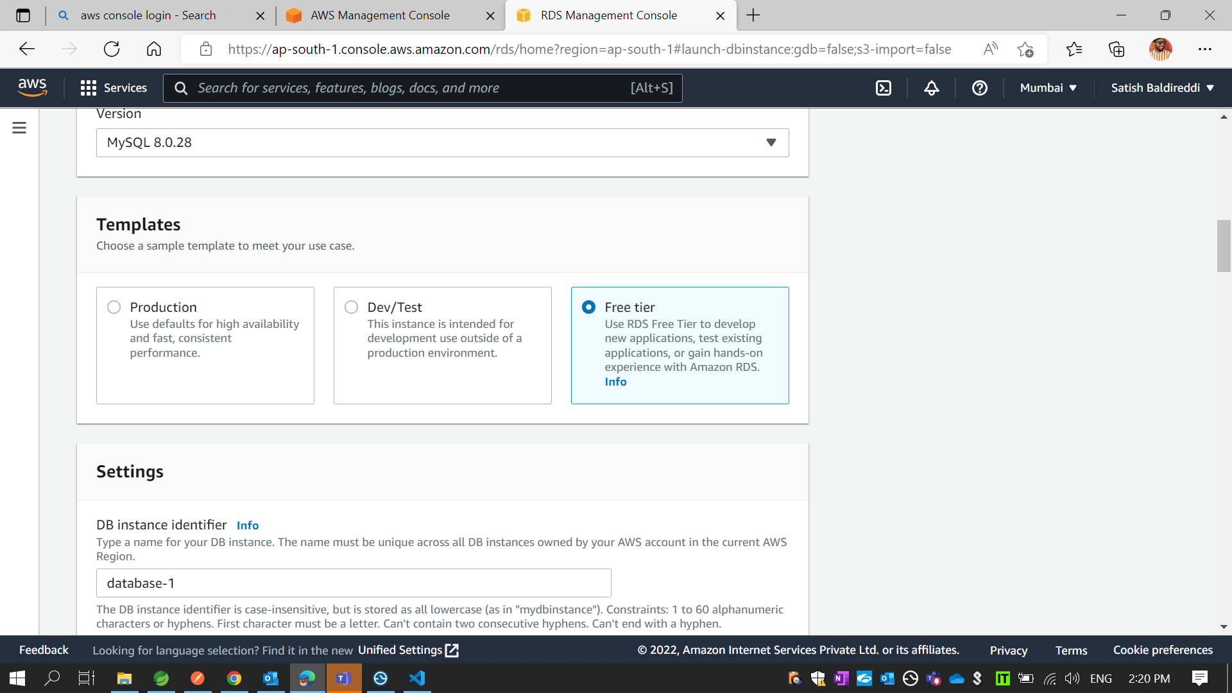
* Select version “MySQL 8.0.28”

Slide 11
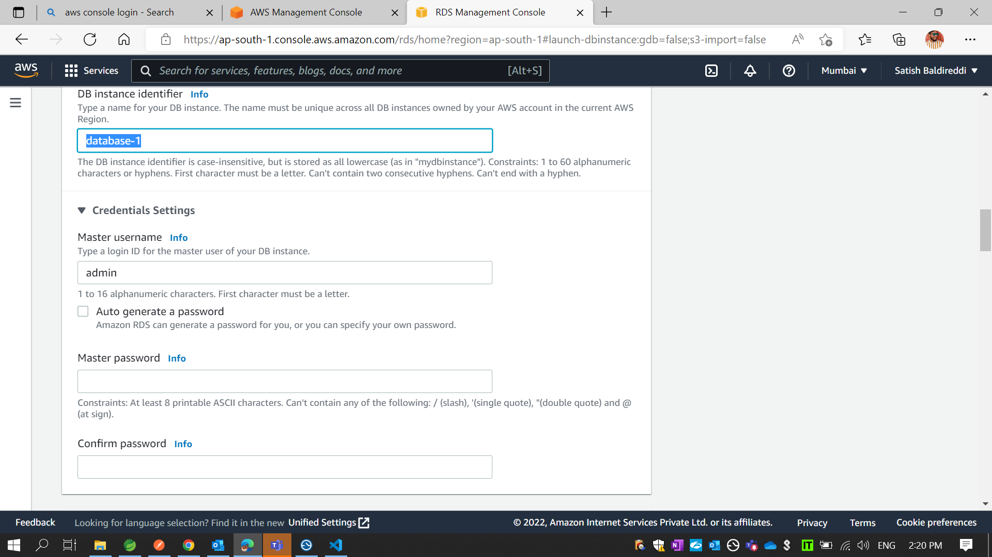
* Set DB instance identifier name ex. “dxcforumdb”

Slide 12
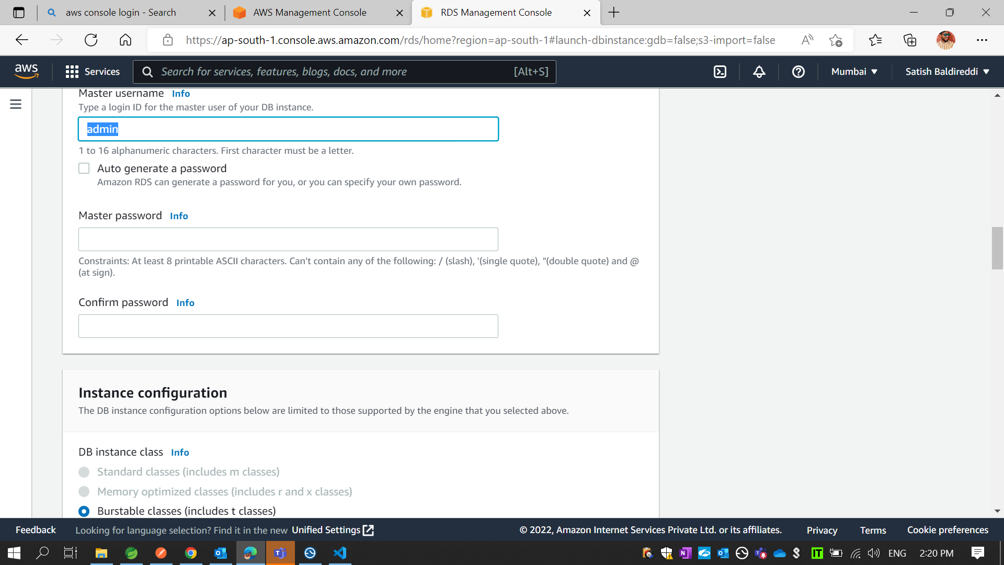
* Type User and Password same as your local database user and password

Slide 13
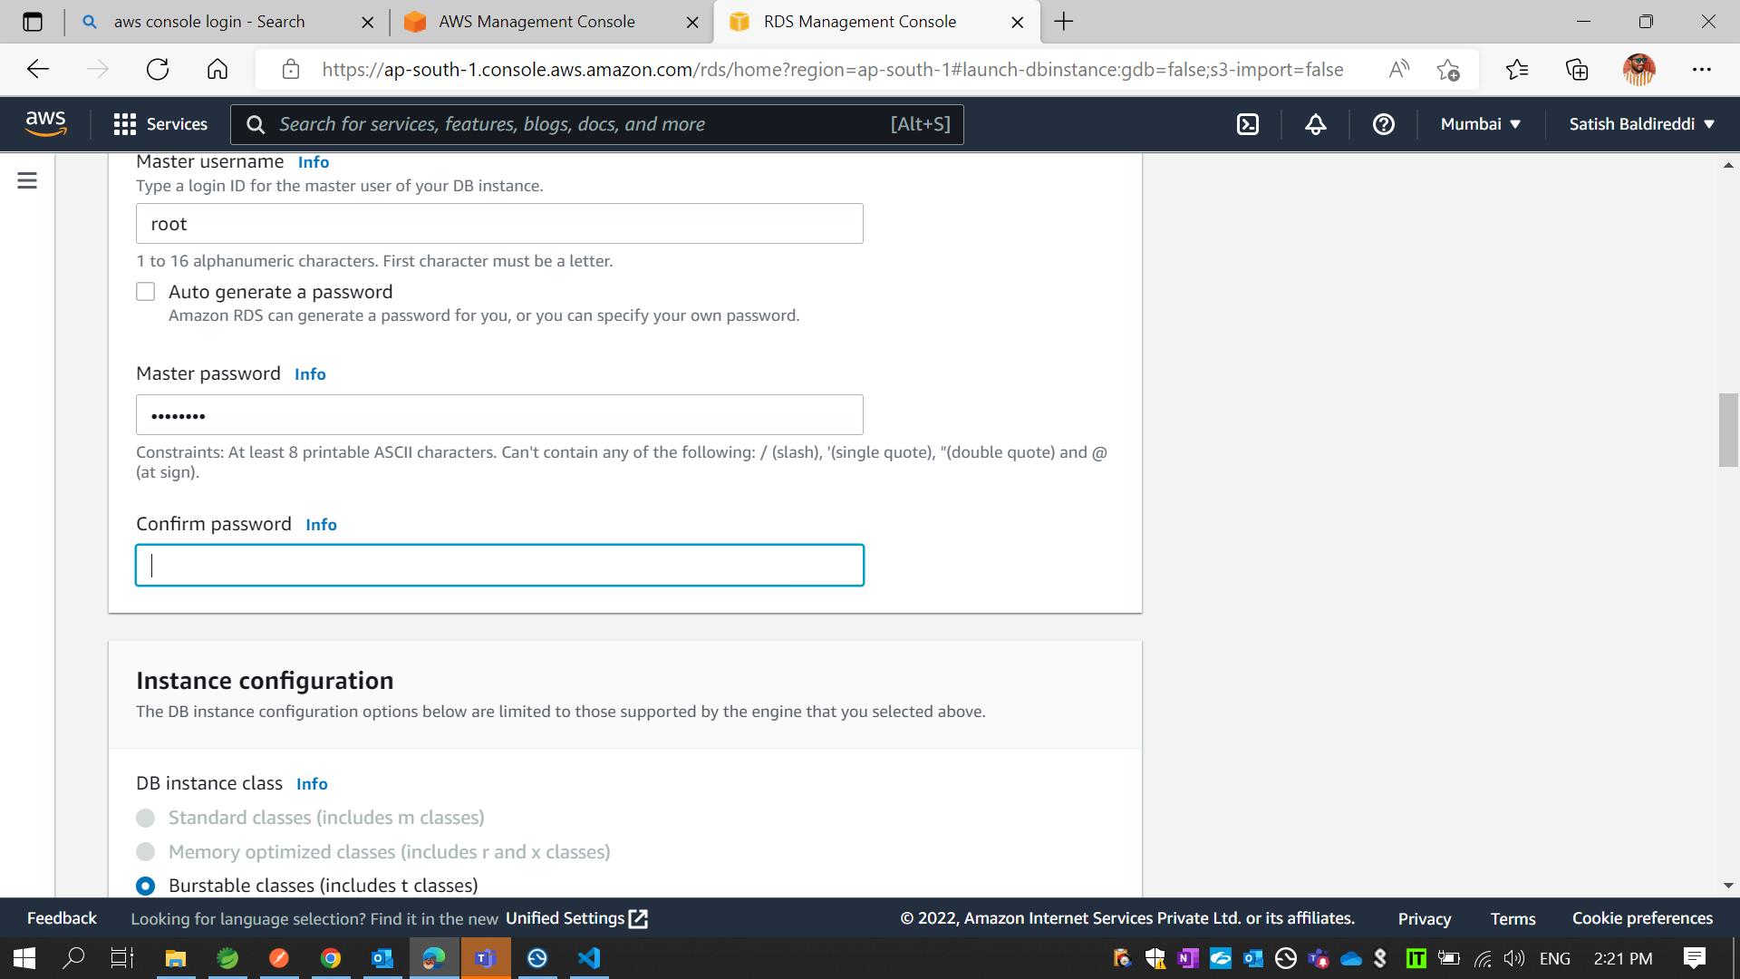

Slide 14
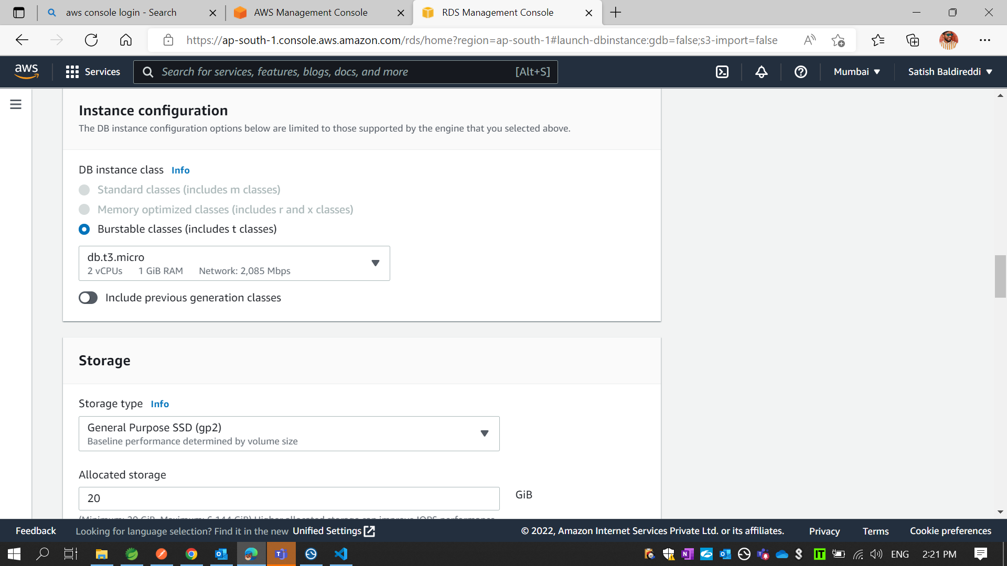

Slide 15
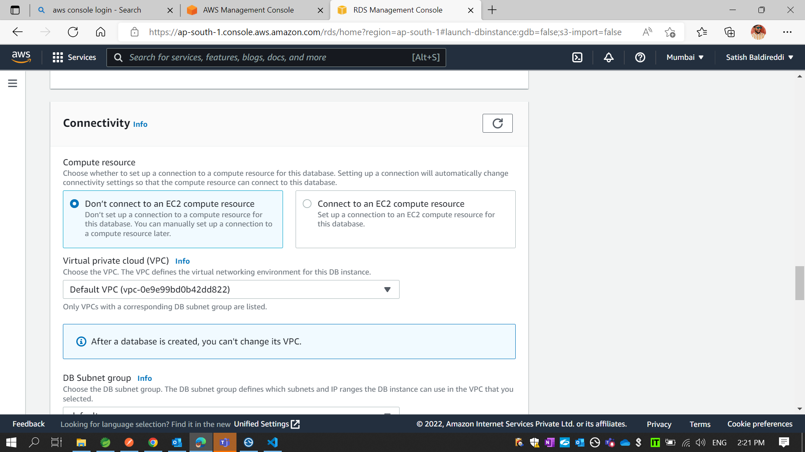

Slide 16
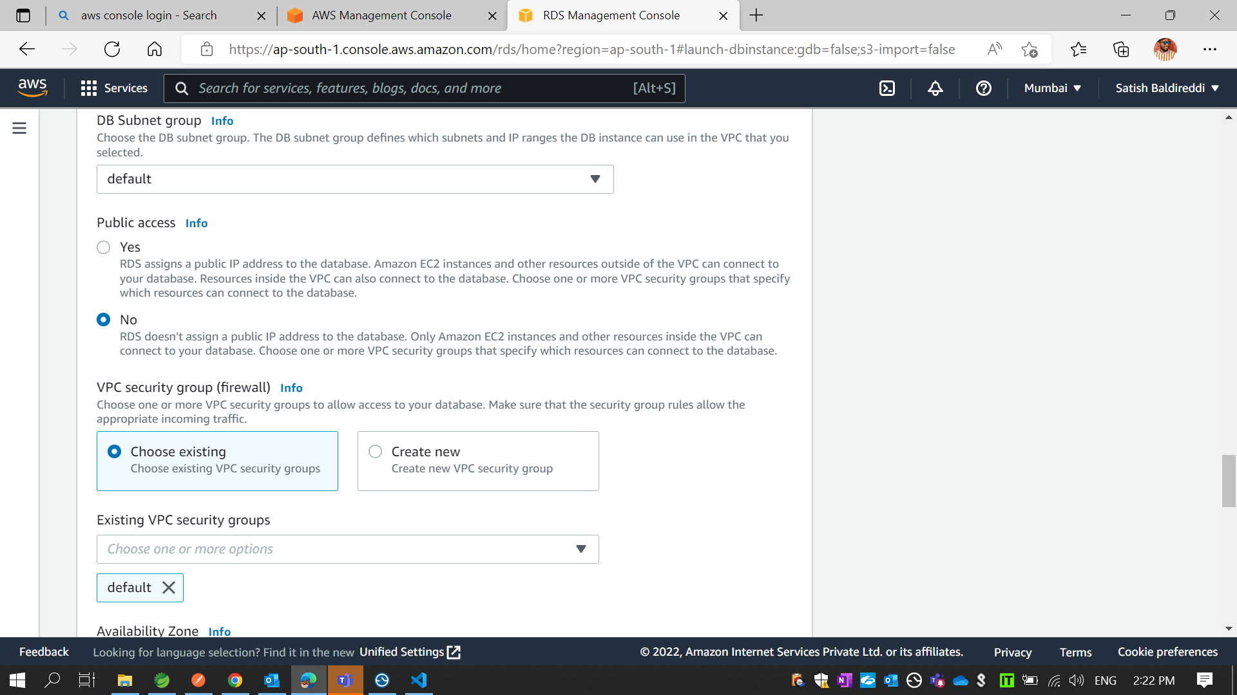
* Change Public Access “Yes” .

Slide 17
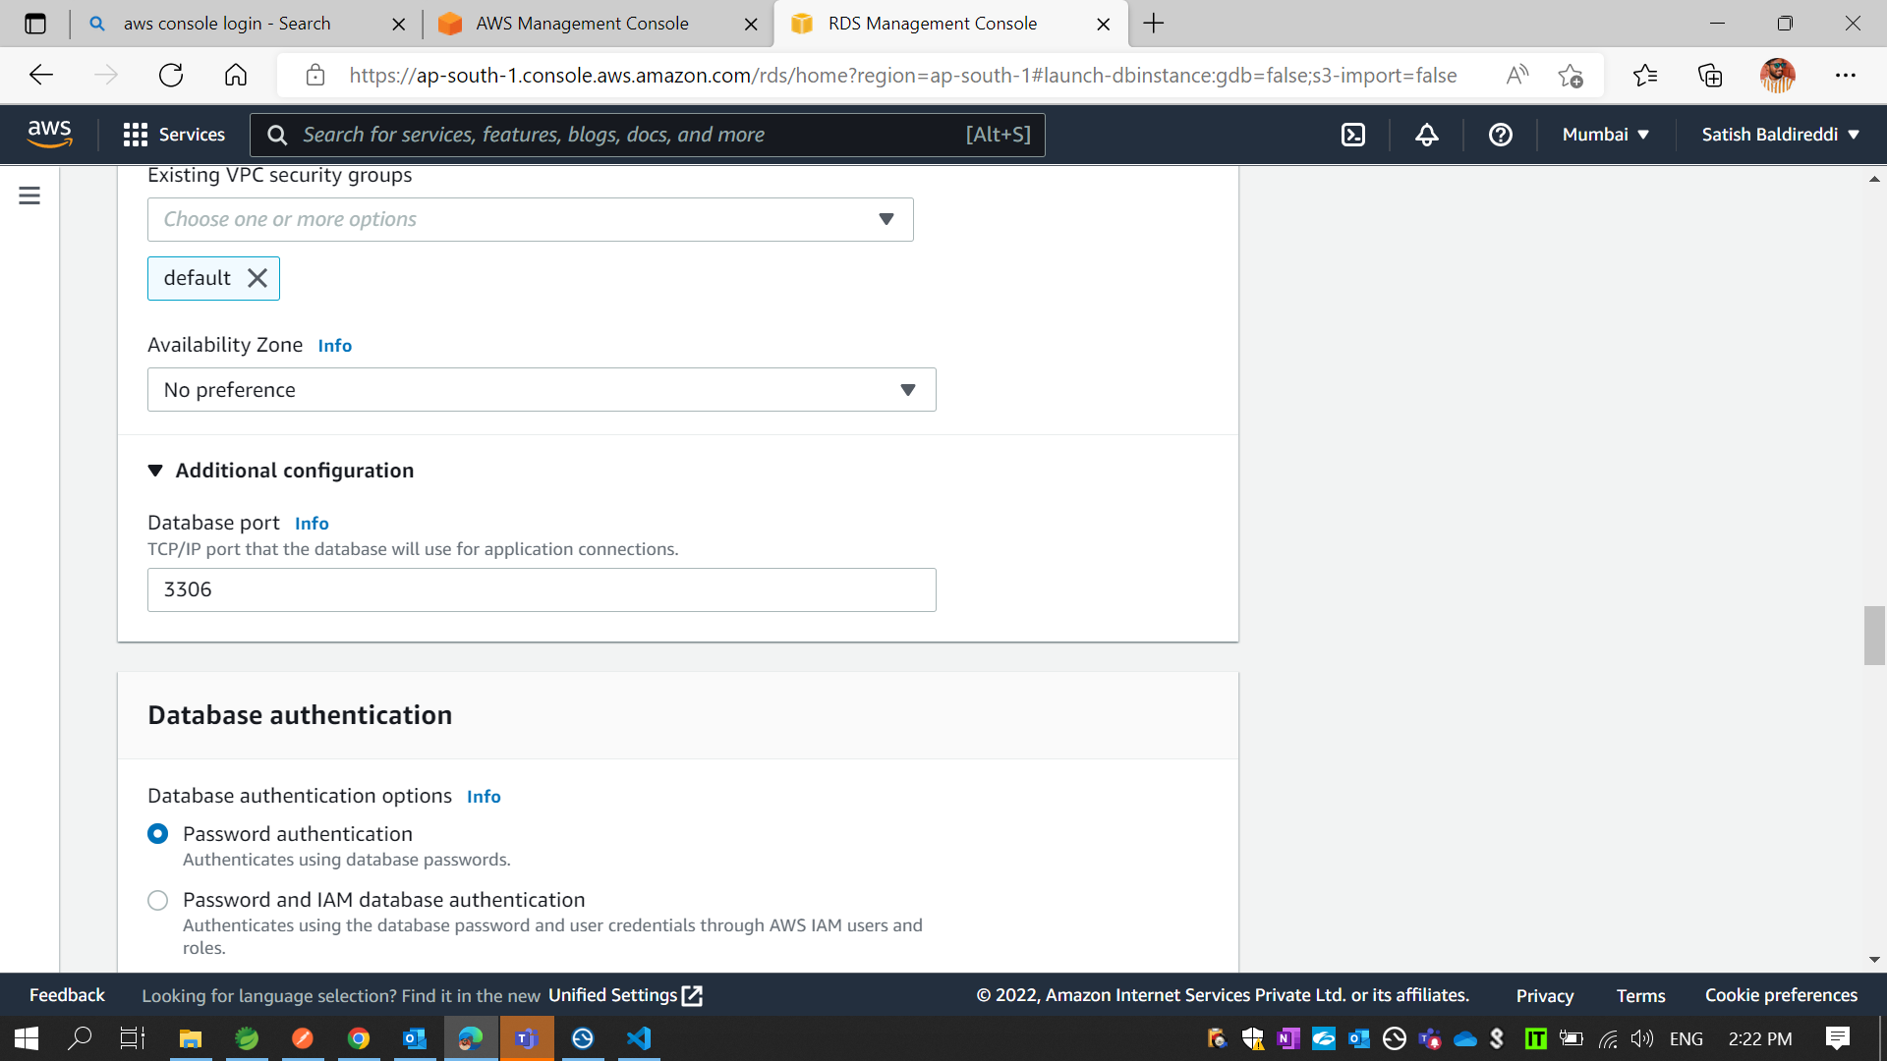
* Click on Additional configuration. Then you see the mysql port no.3306

Slide 18
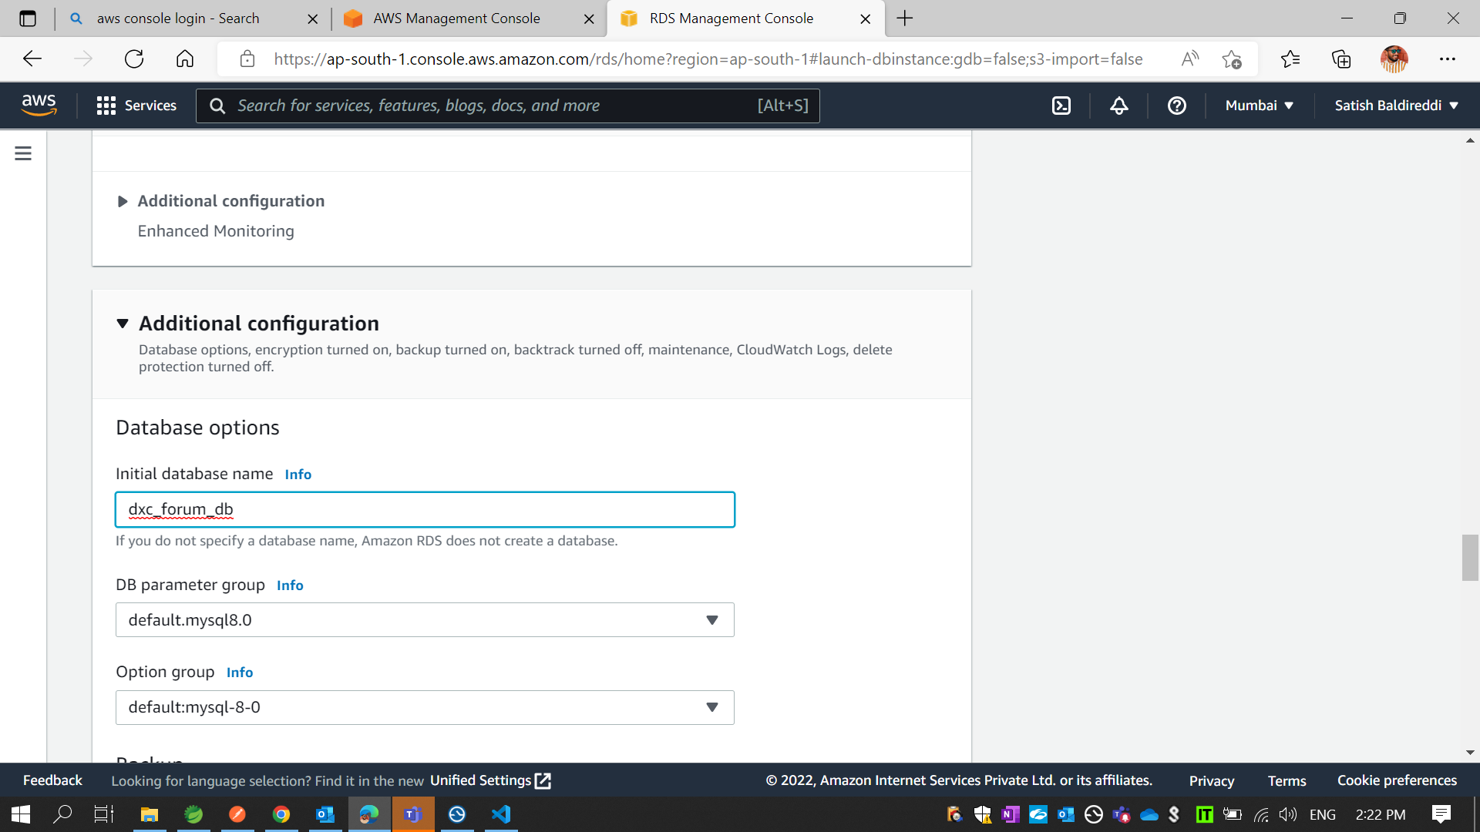
* Click on additional configuration. Then you set database name same as your local schema name

Slide 19
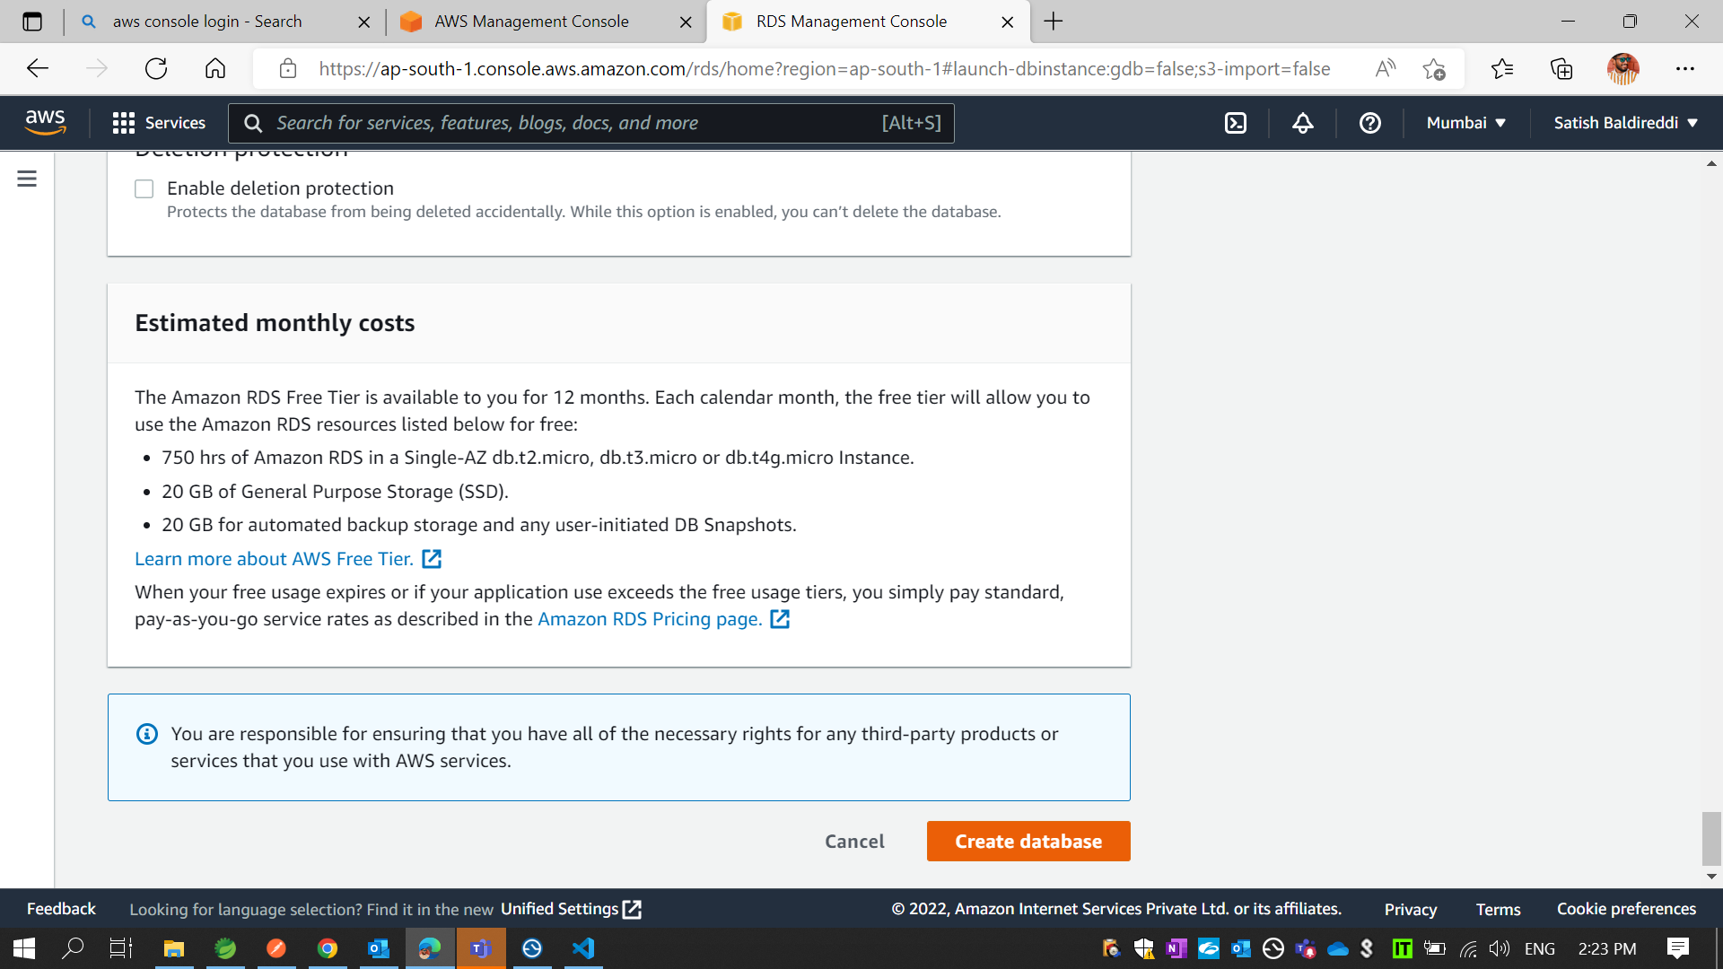
* Then click on Create database

Slide 20
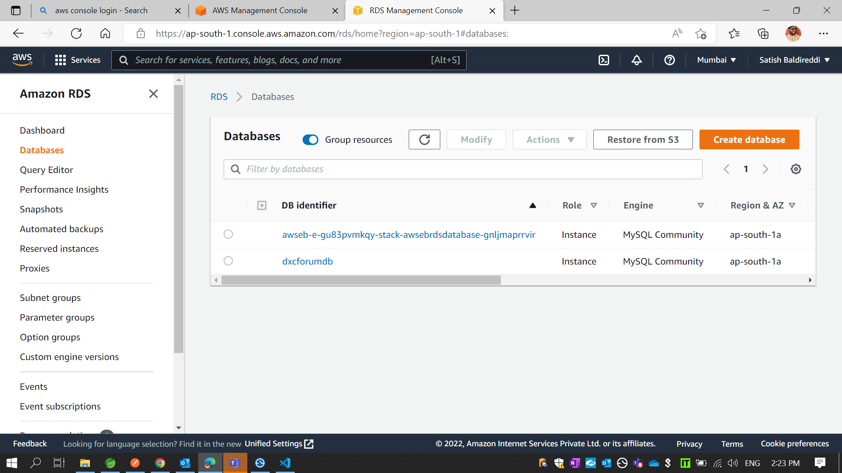
* Then it show database with database instance name like “dxcforumdb”. After that click on dxcforumdb

Slide 21
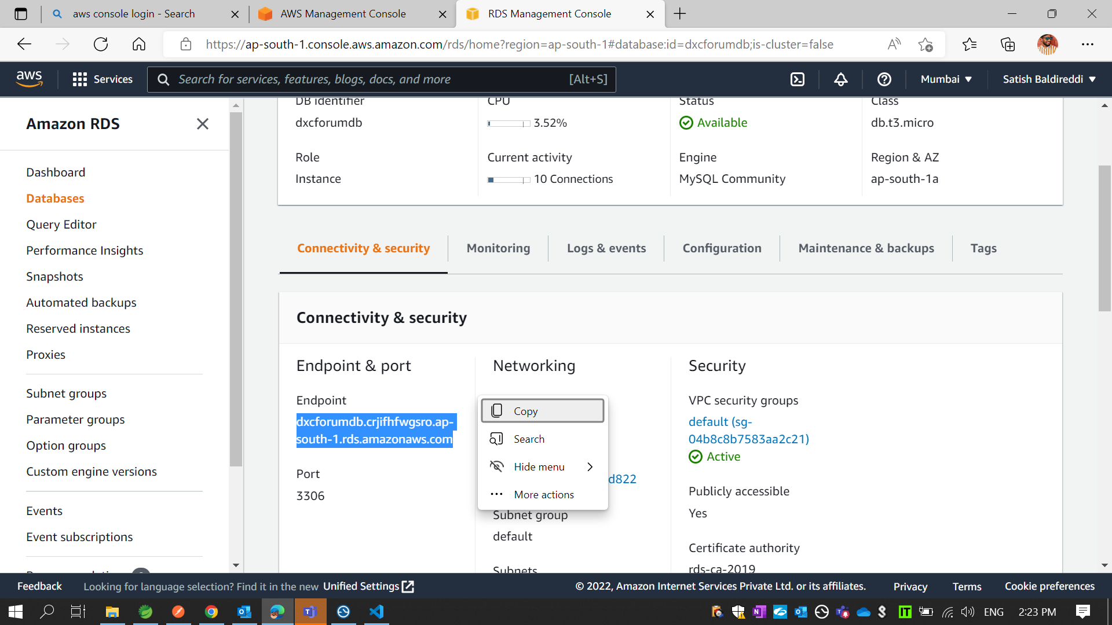
* Just copy that endpoint url

Slide 22
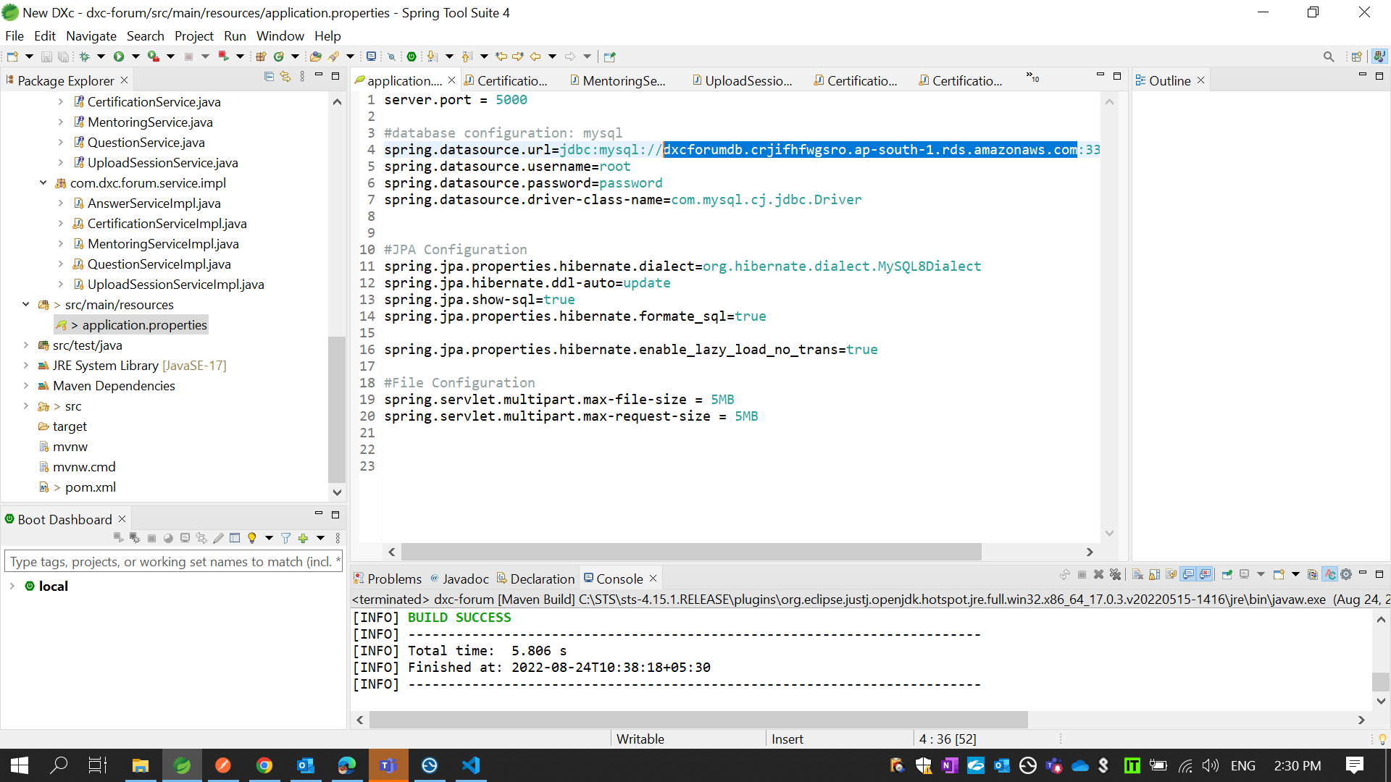
* In your back end code open application.properties file and paste AWS RDS endpoint url in spring.dataSource.url

Slide 23
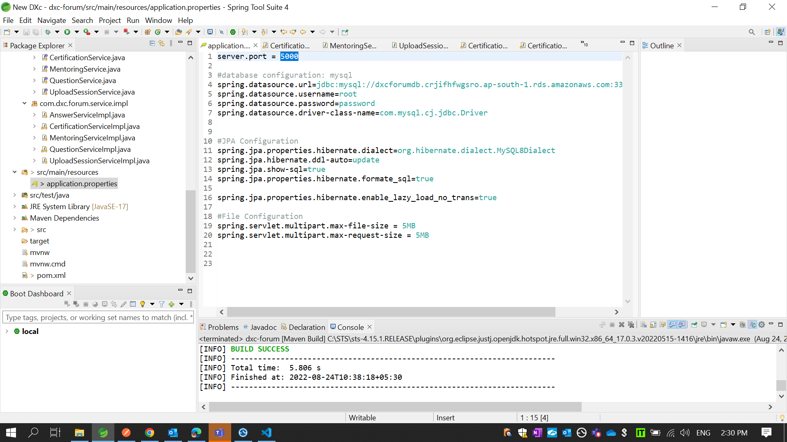
* Change server.port = 5000

Slide 24
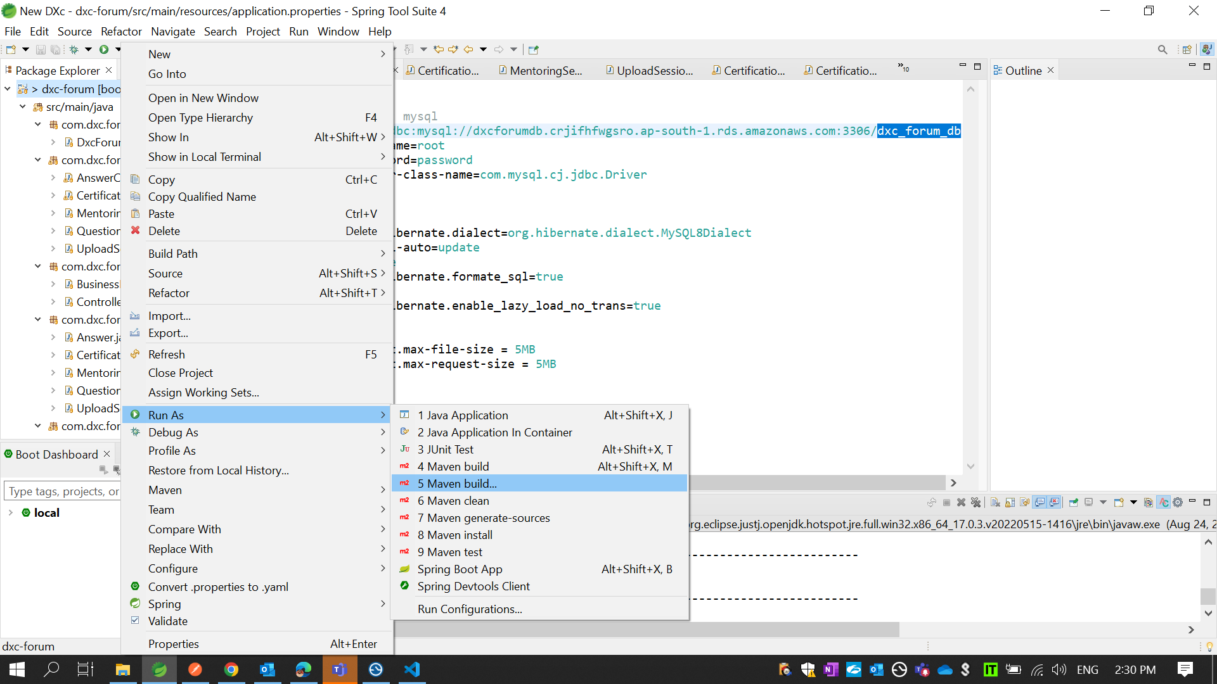
* Click on mevan build and create a jar file

Slide 25
* Click on Elastic Beanstalk

Slide 26
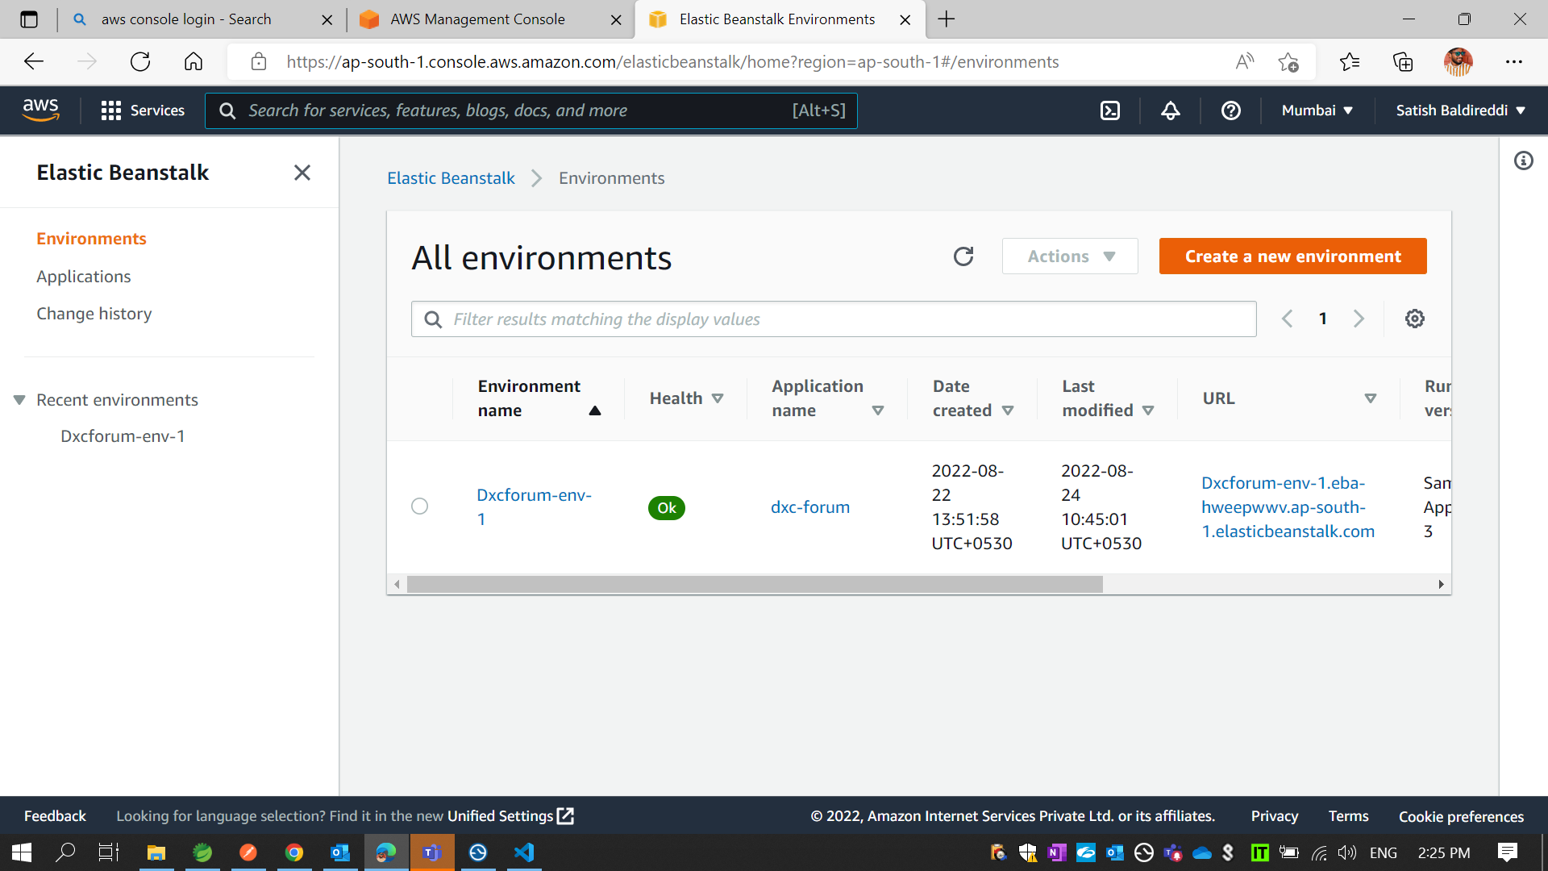
* Click on Create a new environment

Slide 27
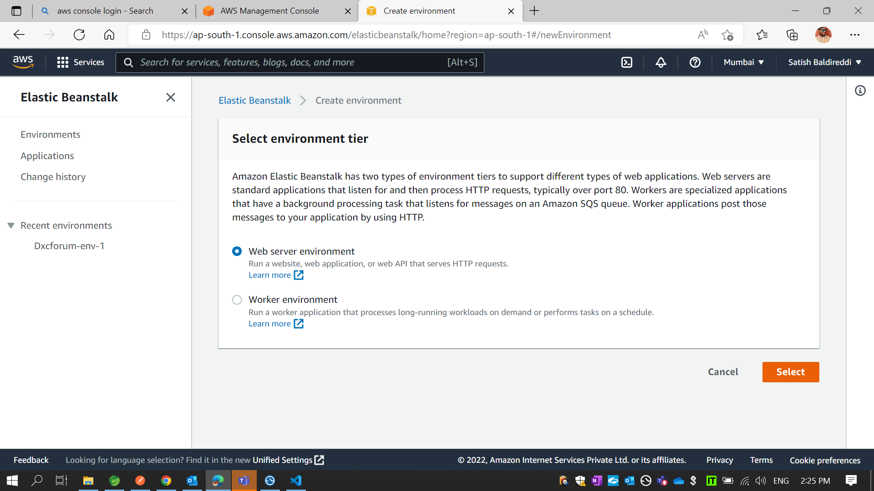
* Select Web Server environment and Click on Select

Slide 28
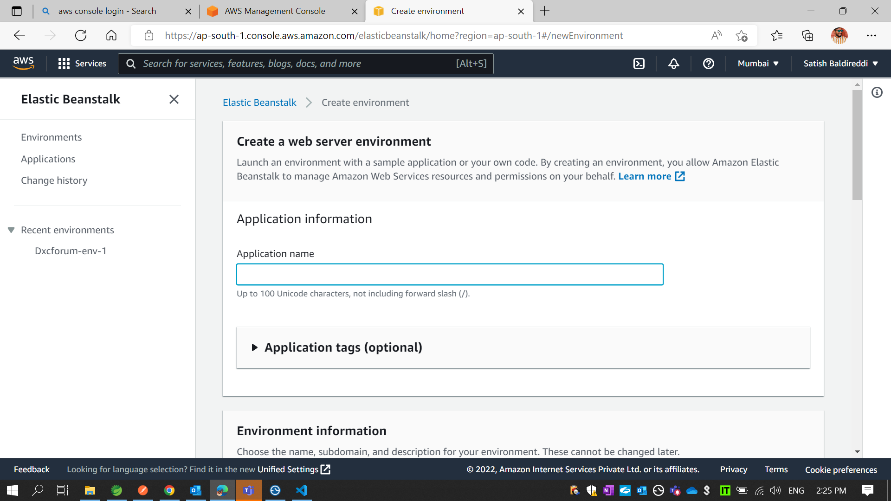
* Write Application name

Slide 29
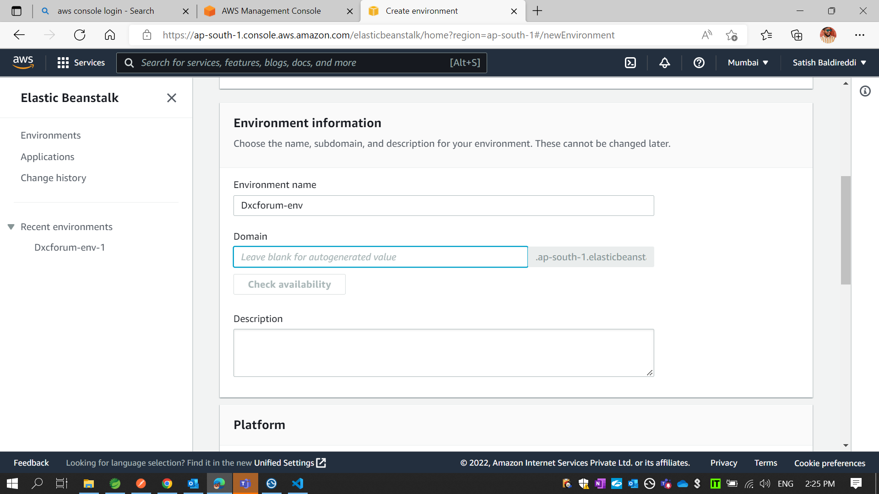
* Add Domain name

Slide 30
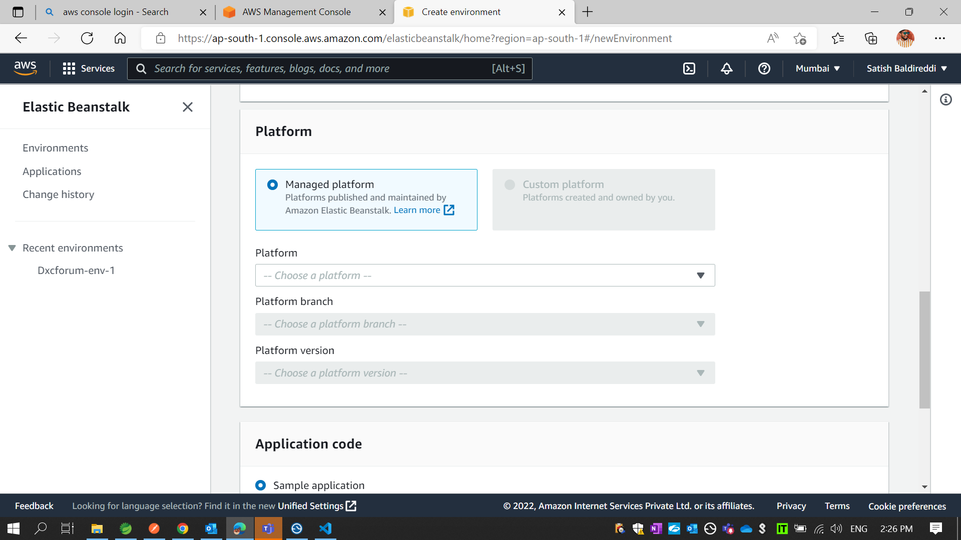

Slide 31
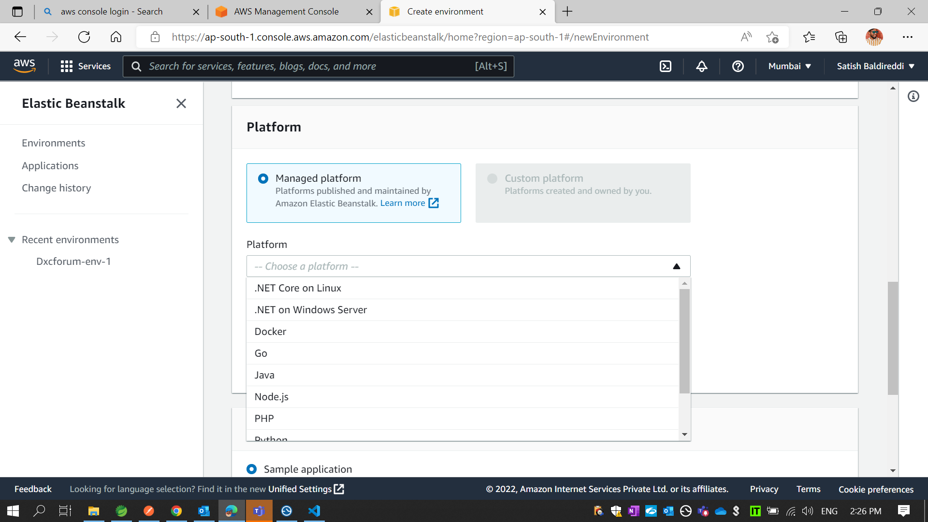
* Choose a Platform

Slide 32
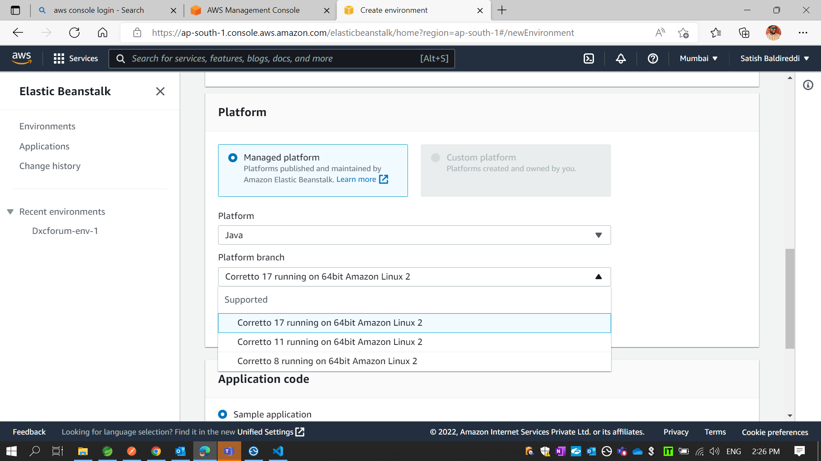
* Choose Version

Slide 33
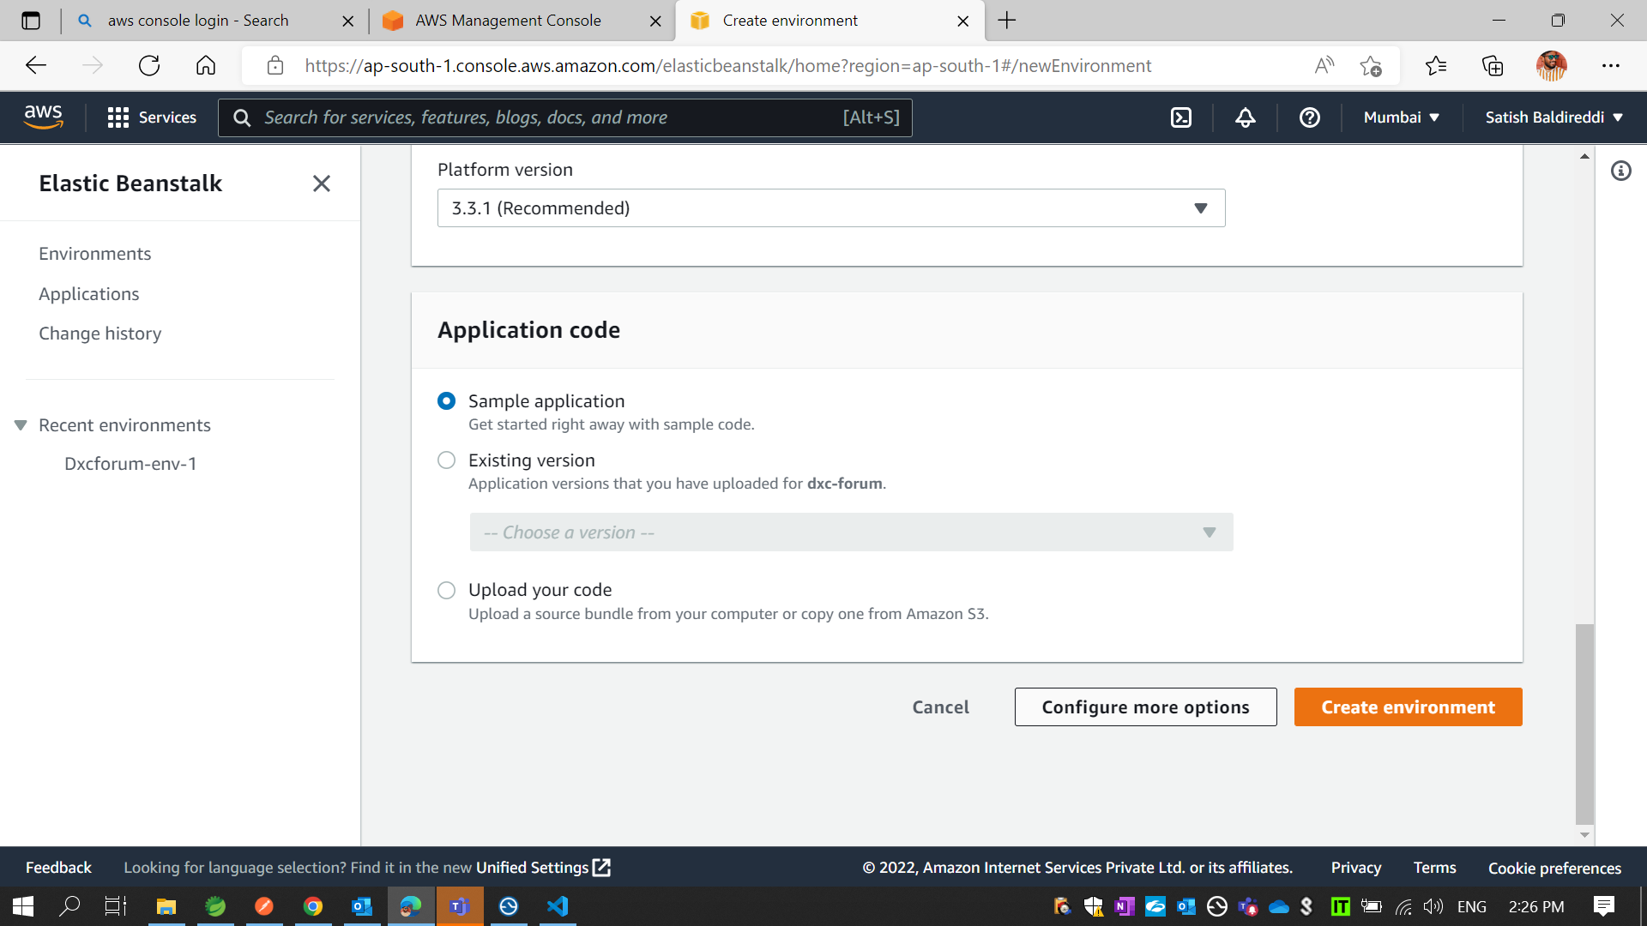
* Click on Configure more options

Slide 34
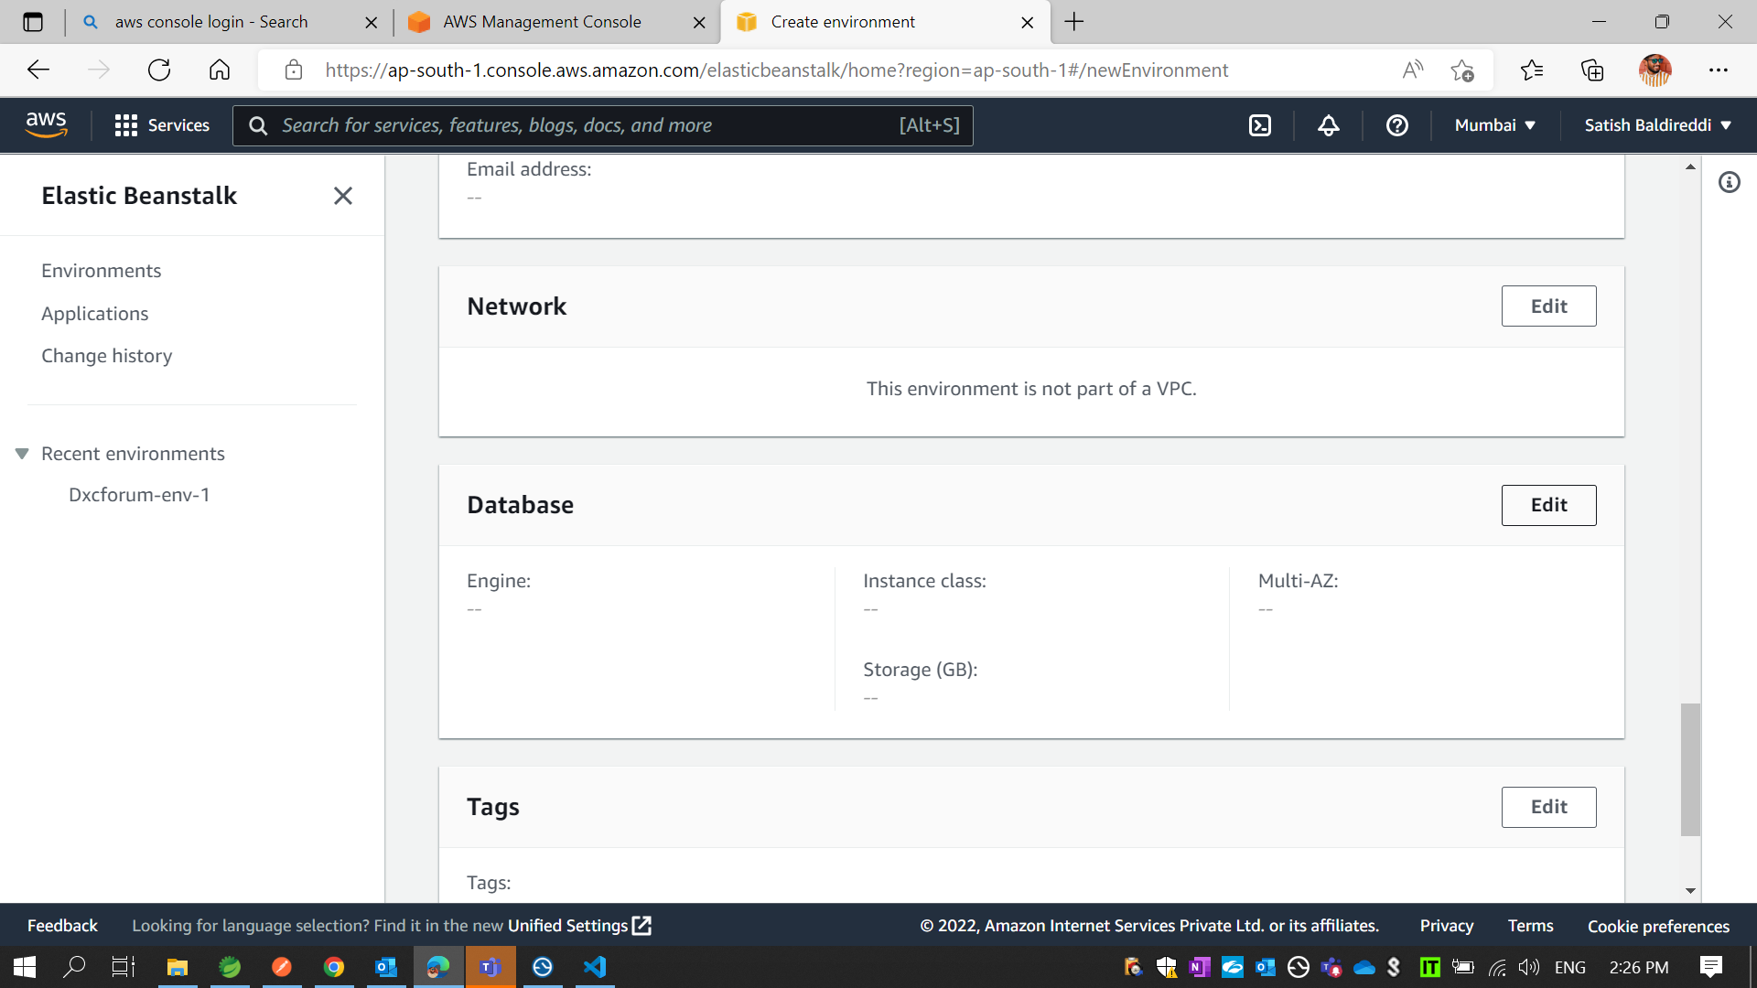
* In Database Click on Edit

Slide 35
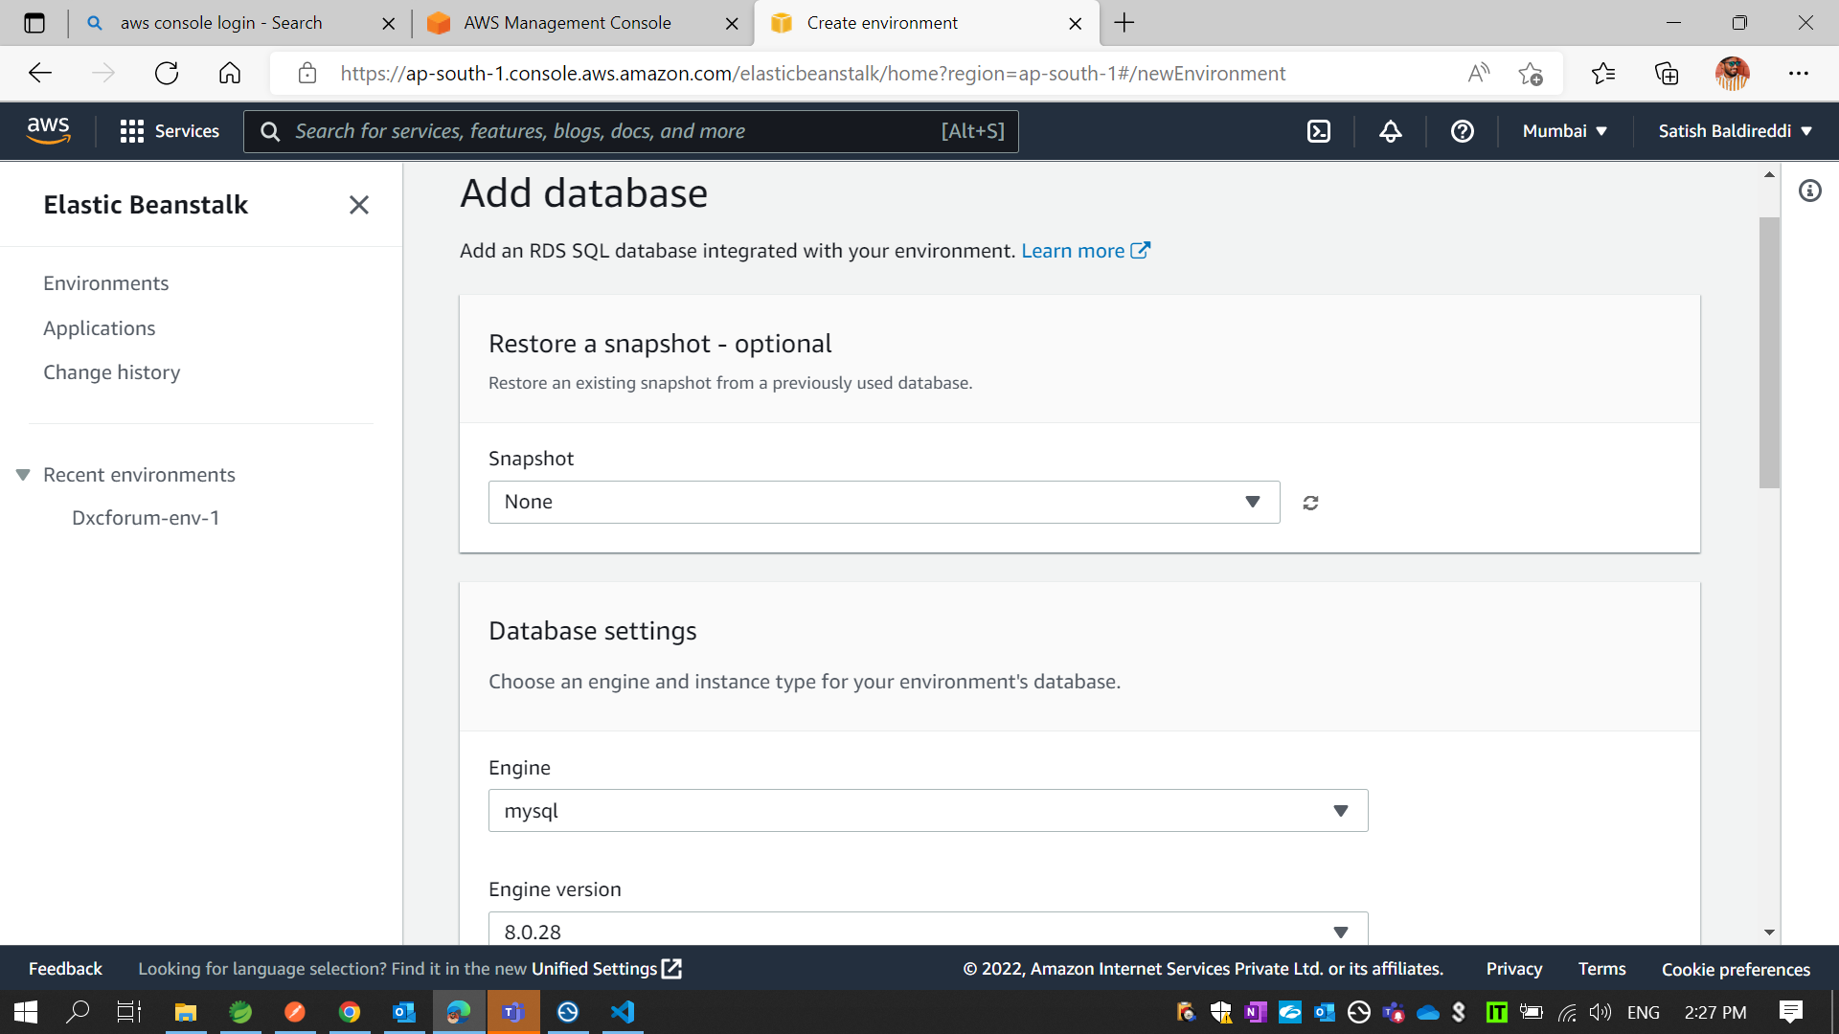

Slide 36
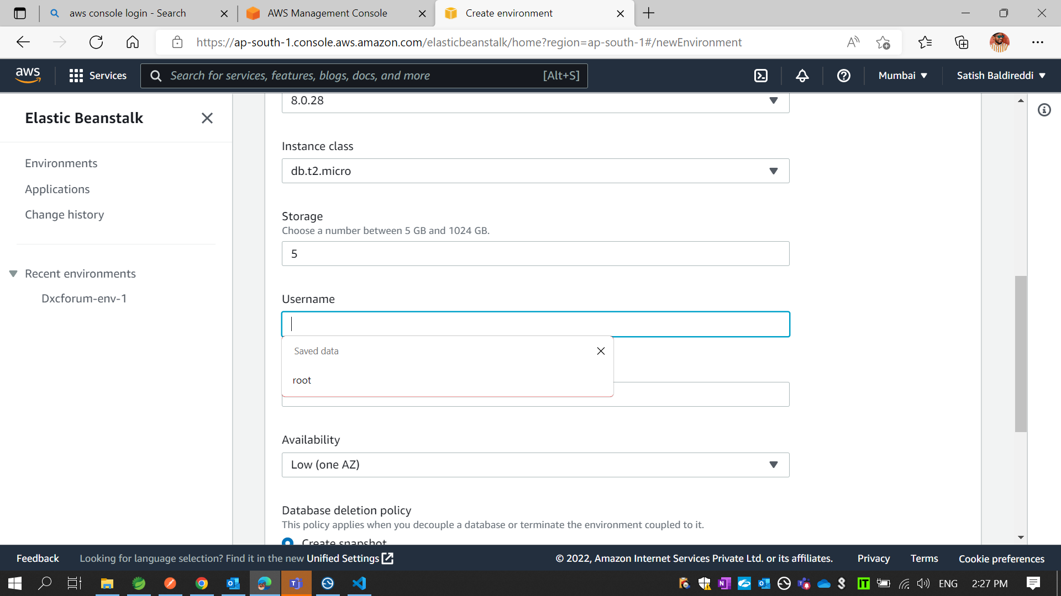
* In add database Add username and password

Slide 37
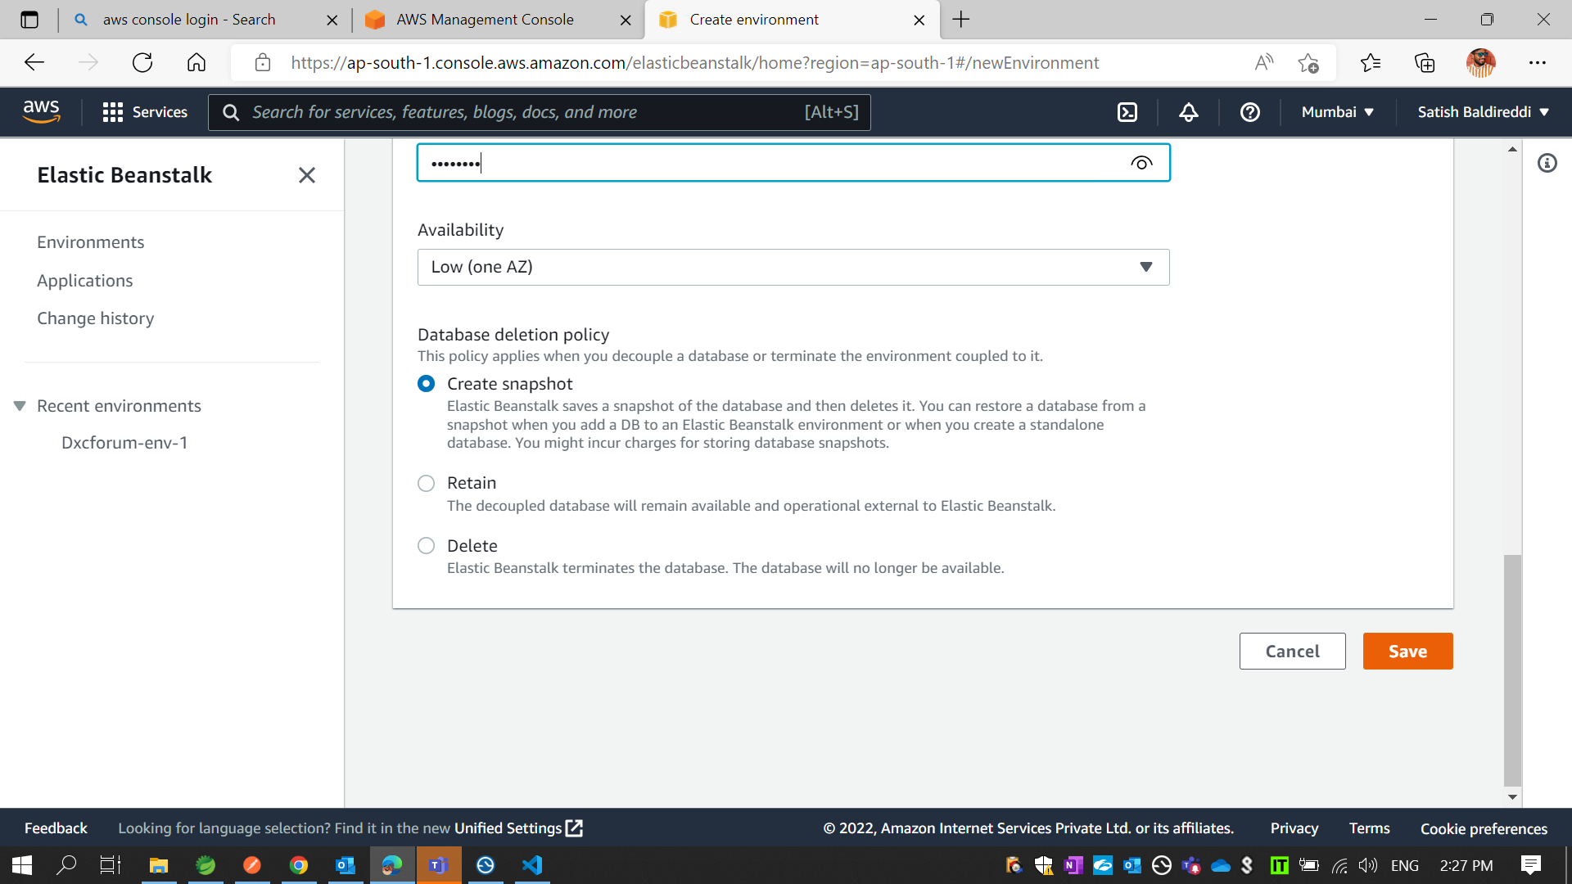

Slide 38
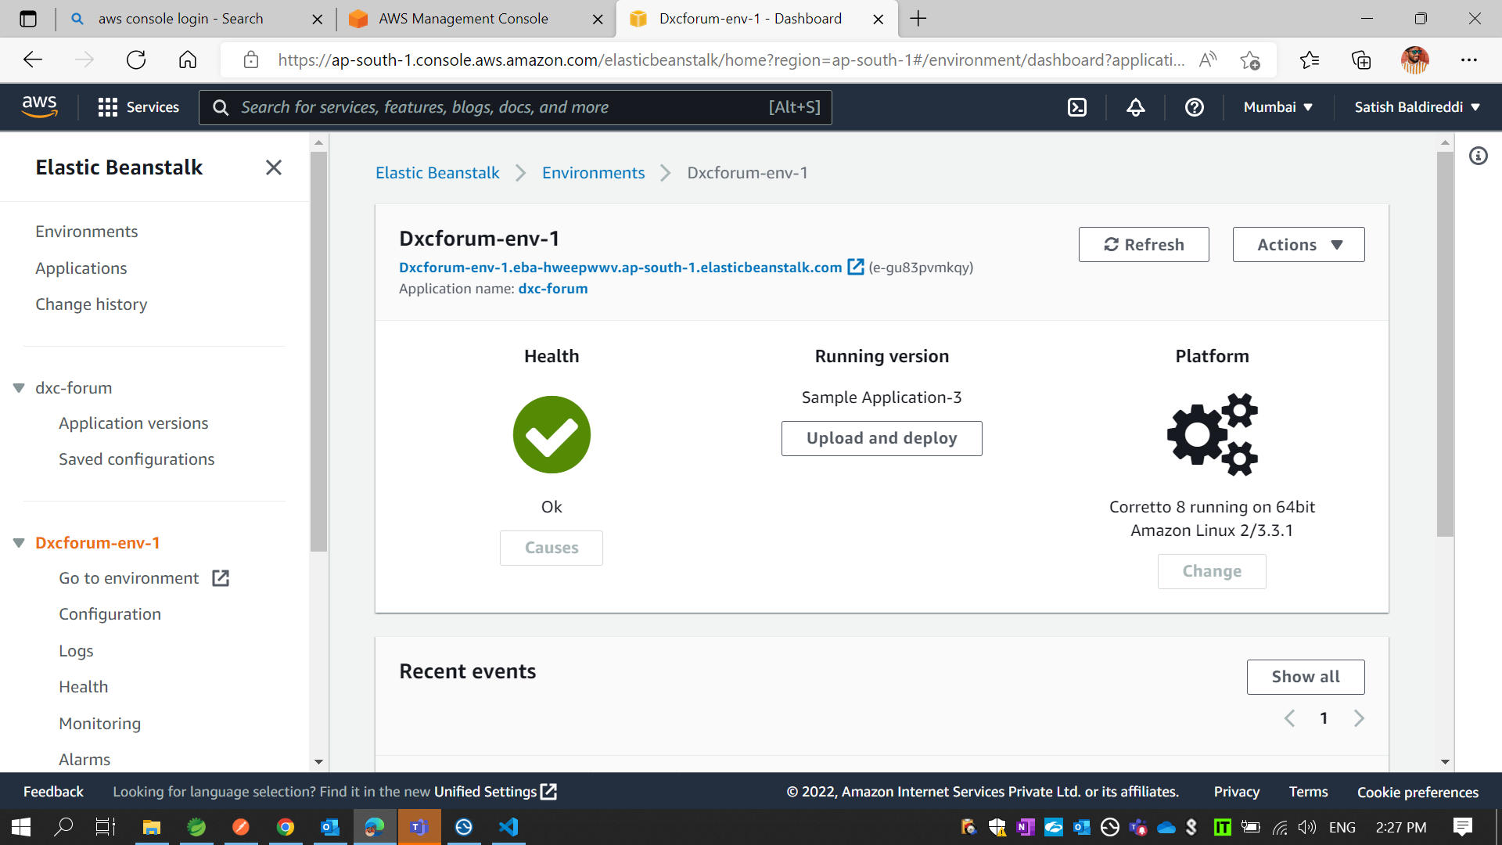
* If every thing is good. Then you get Health is Ok. If you miss any thing you get Health is WARN

Slide 39
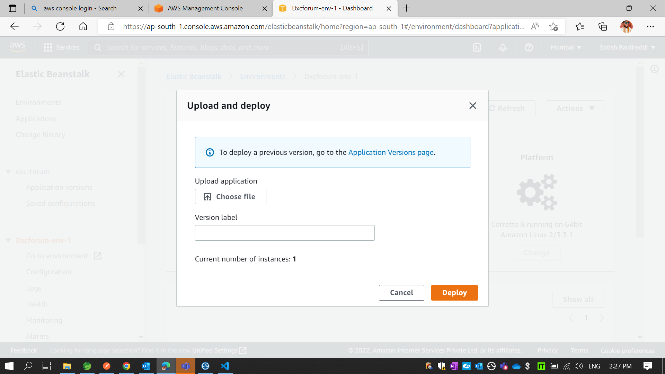
* If Health is Ok. Then Click on Upload and deploy

Slide 40
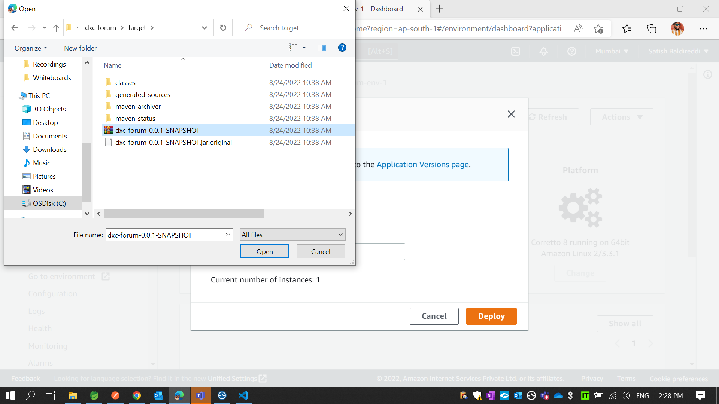
* Add your Back end code Jar file and Click On Deploy

Slide 41
* If every thing is good. Then you get Health is Ok. If you miss any thing you get Health is Degraded

Slide 42
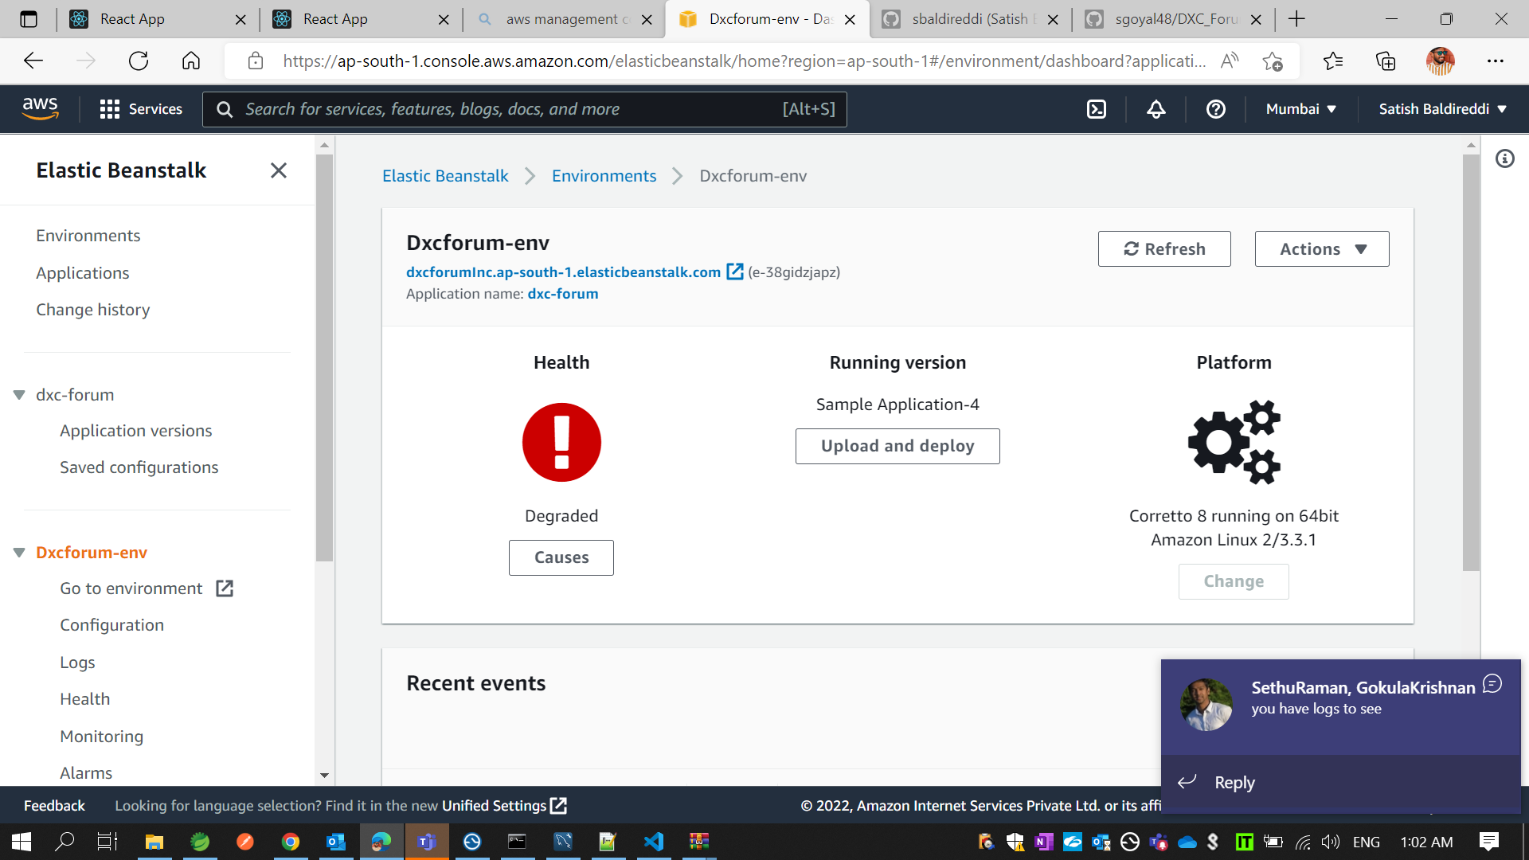
* Like this

Slide 43
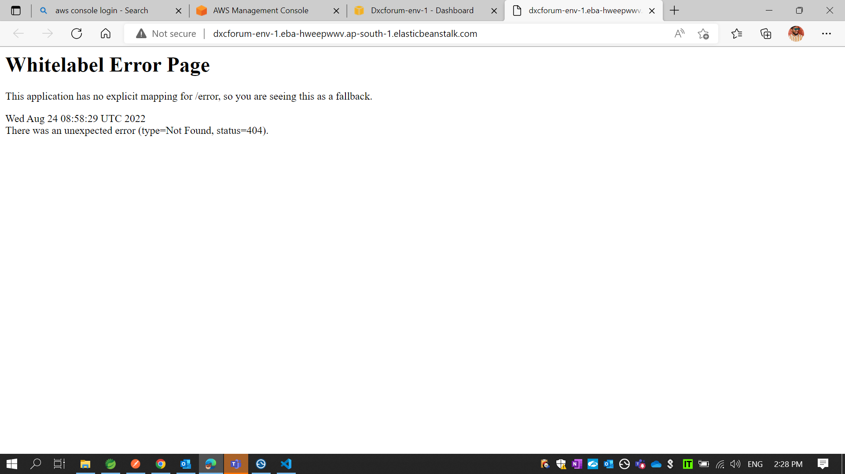
* If Health is Ok. Then Click on URL which you get in Environment Then you get like this

Slide 44
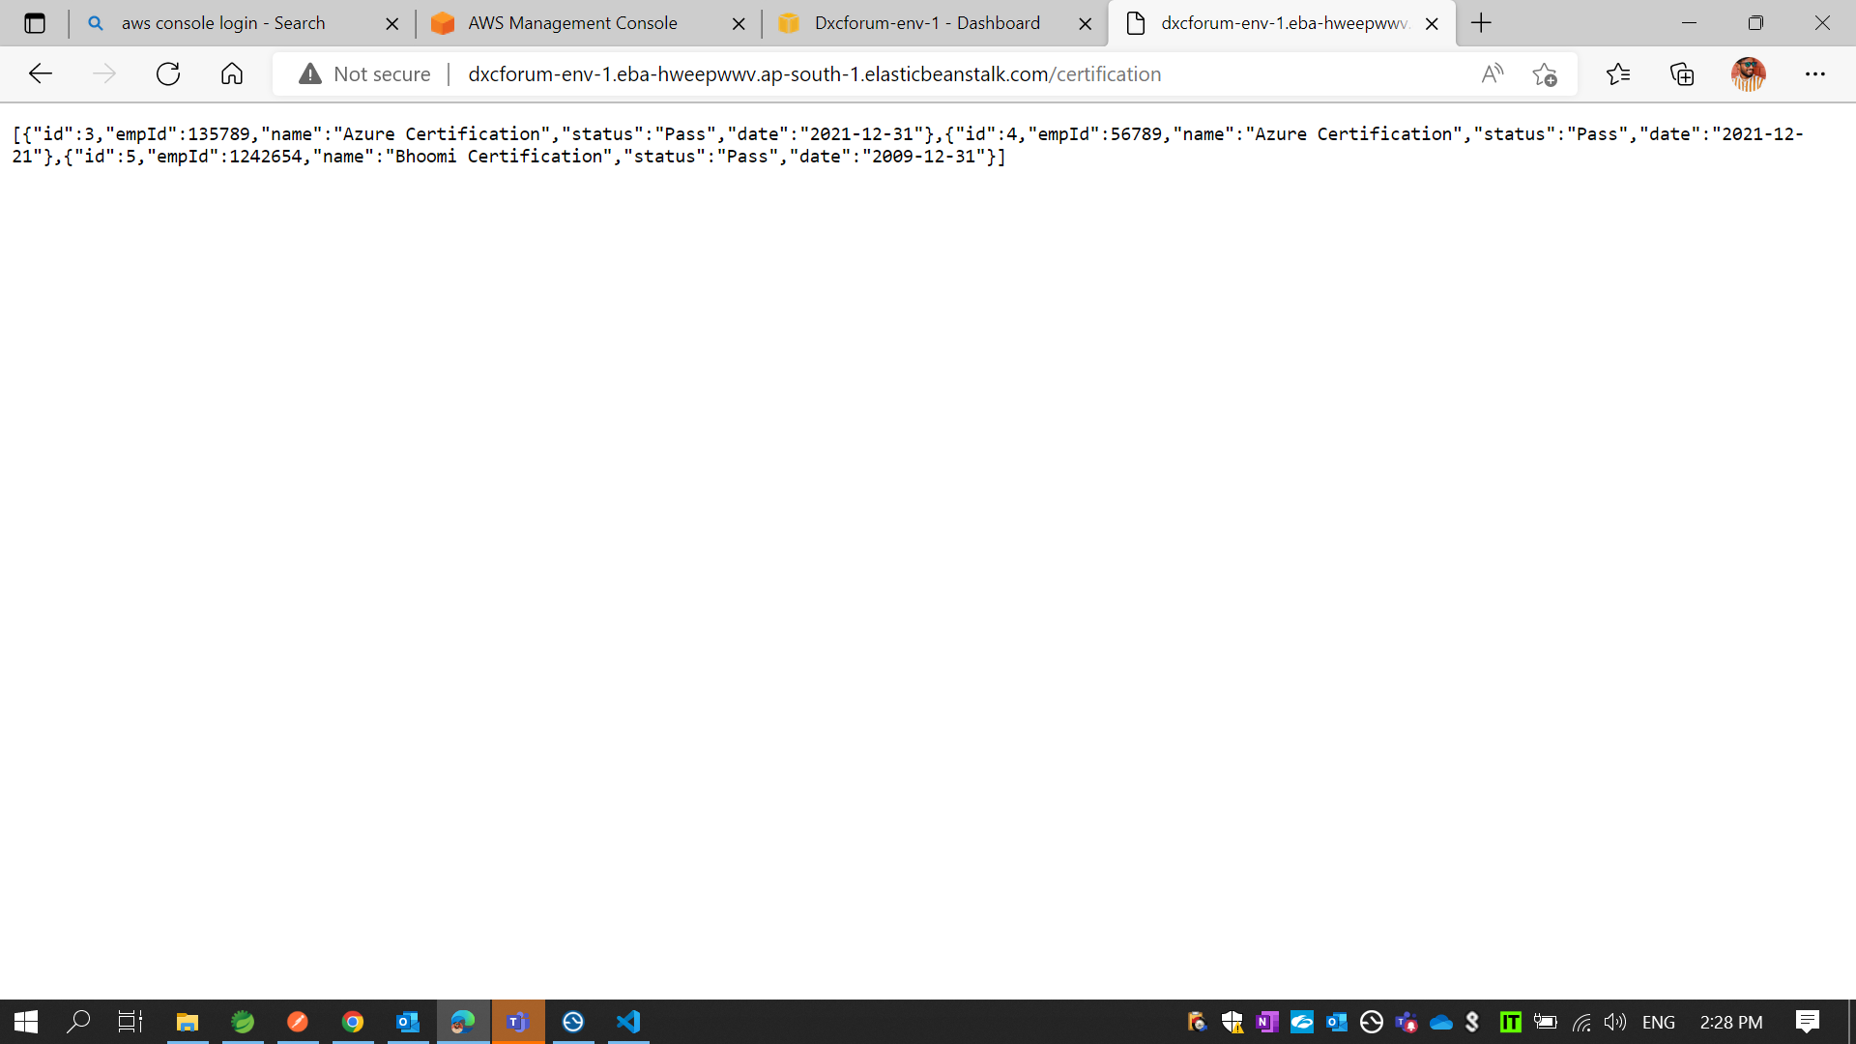
* Then add your server endpoint. If Record are available in your AWS Database it will show in your browser else empty [].

Slide 45
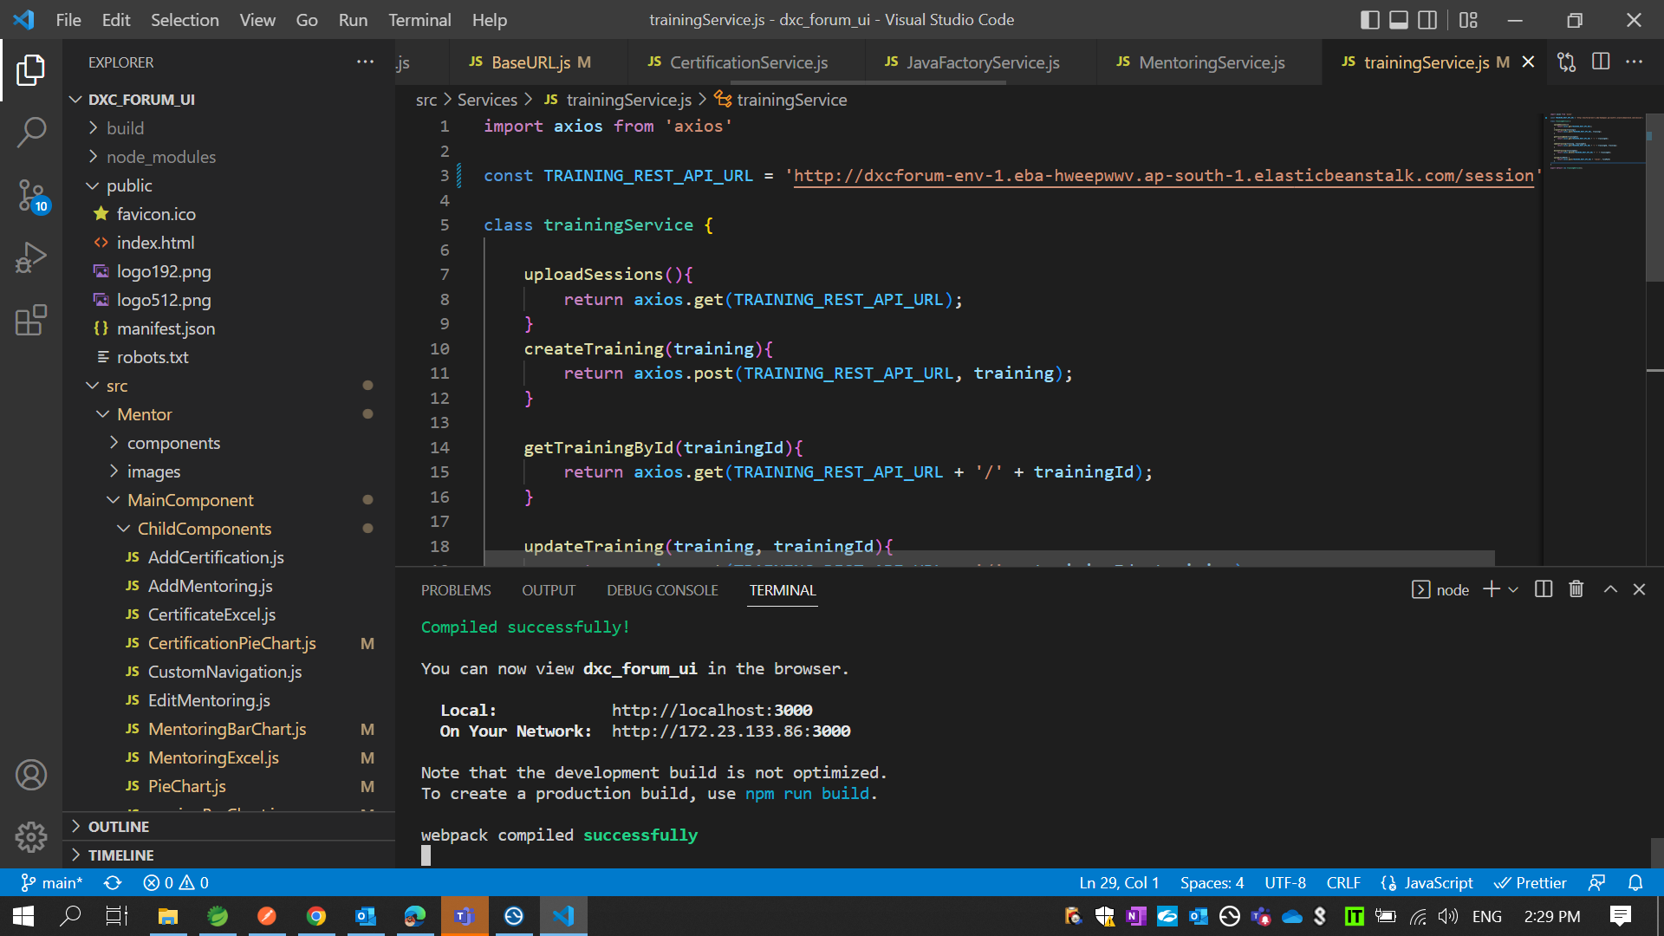
* Then replace your AWS Elastic Beanstalk server URL to your front code where you are use your embedded server URL

Slide 46
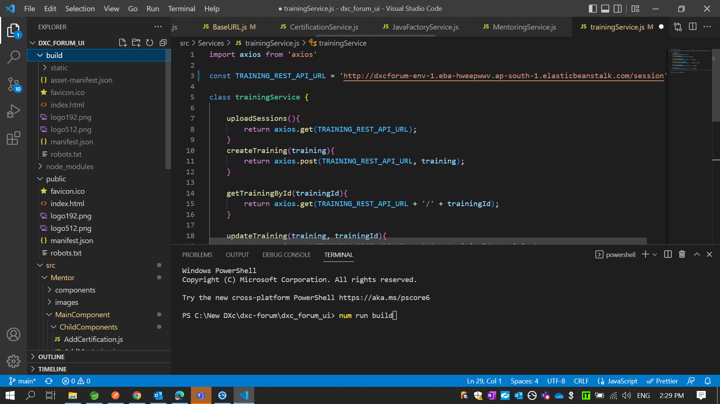
* Create one build folder use commend npm run build

Slide 47
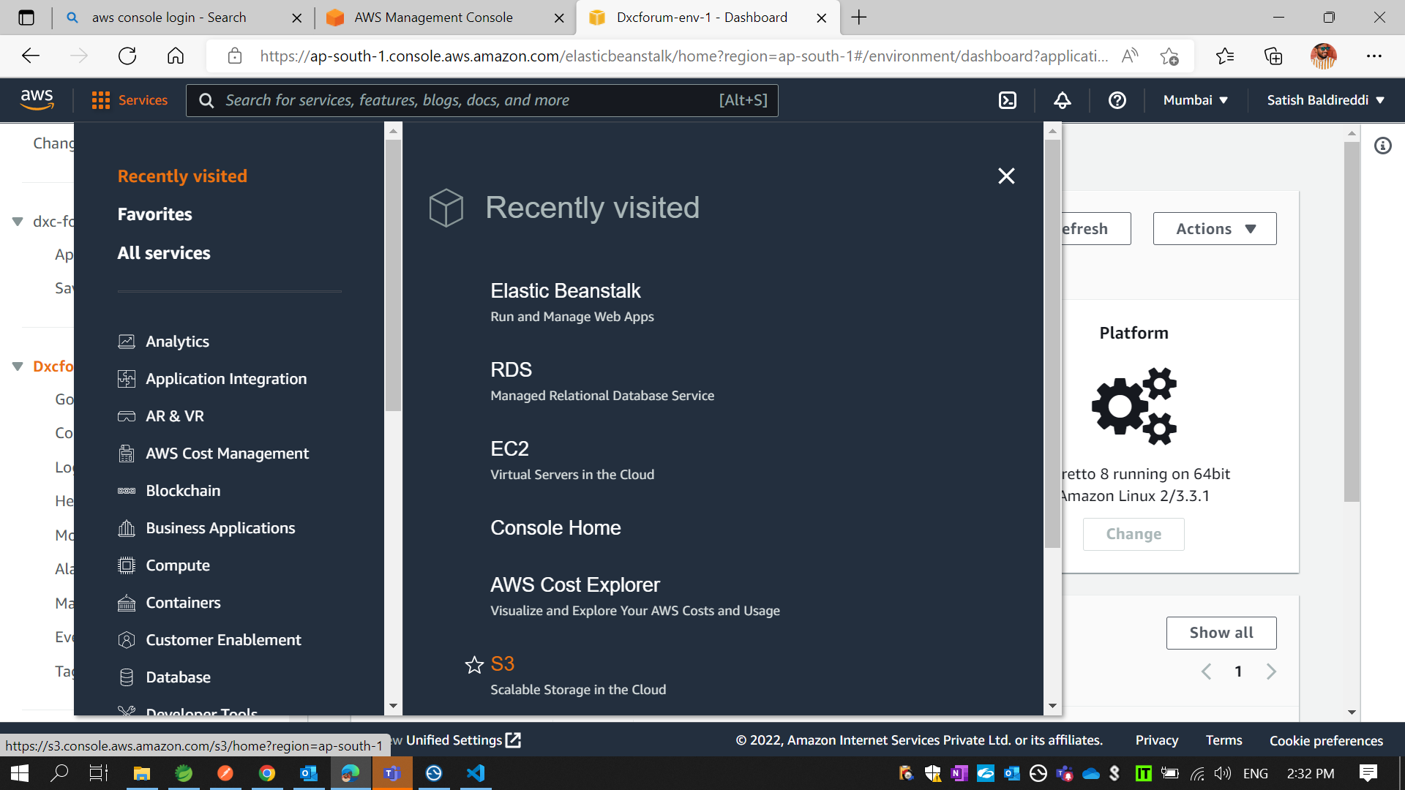
* Then go to AWS Services and Select S3

Slide 48
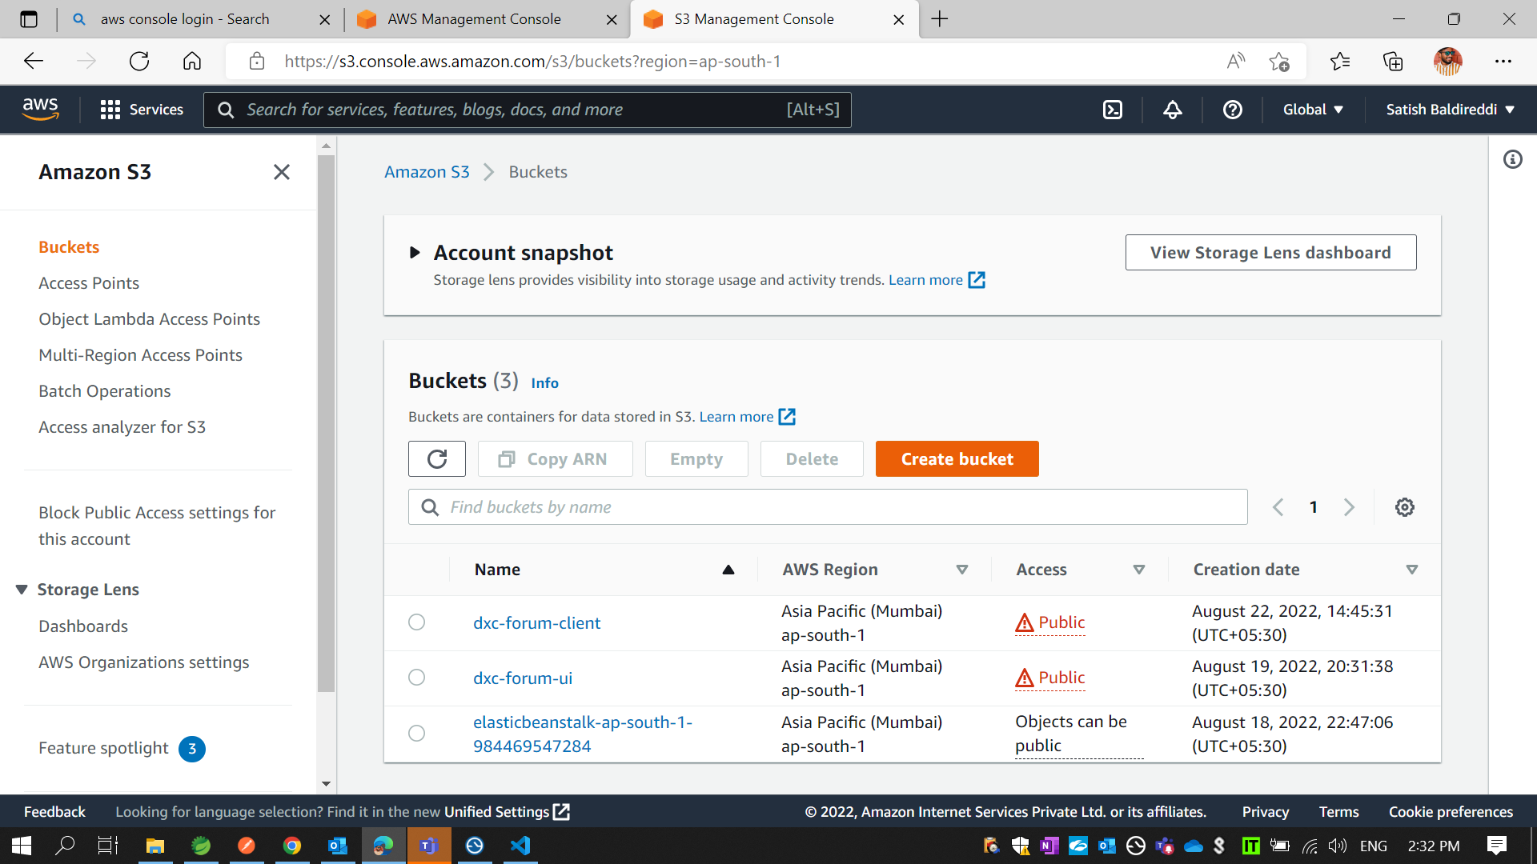
* Click on Create bucket

Slide 49
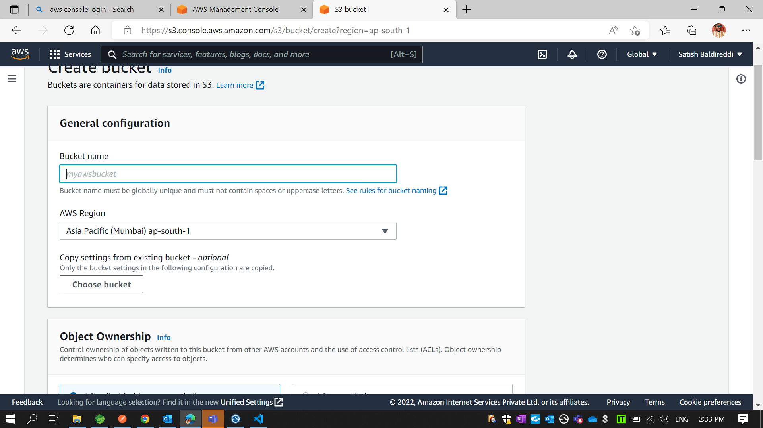
* Add Bucket name

Slide 50
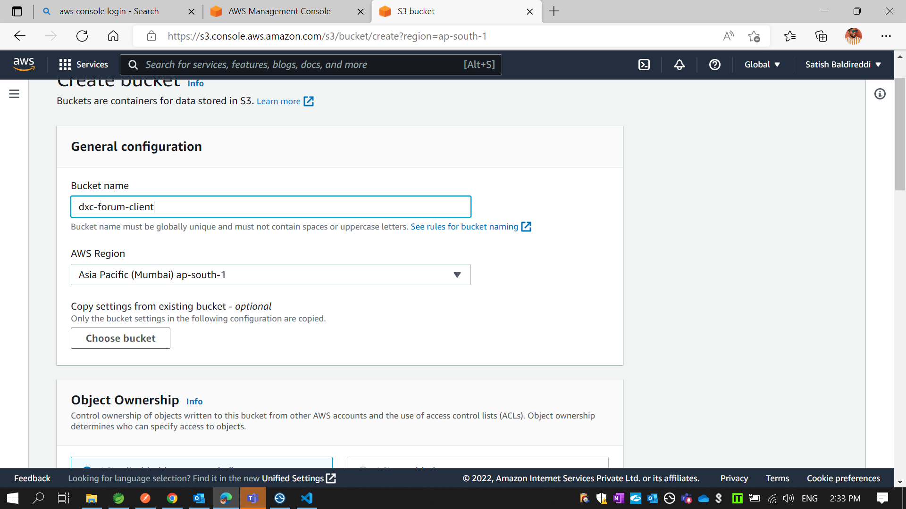

Slide 51
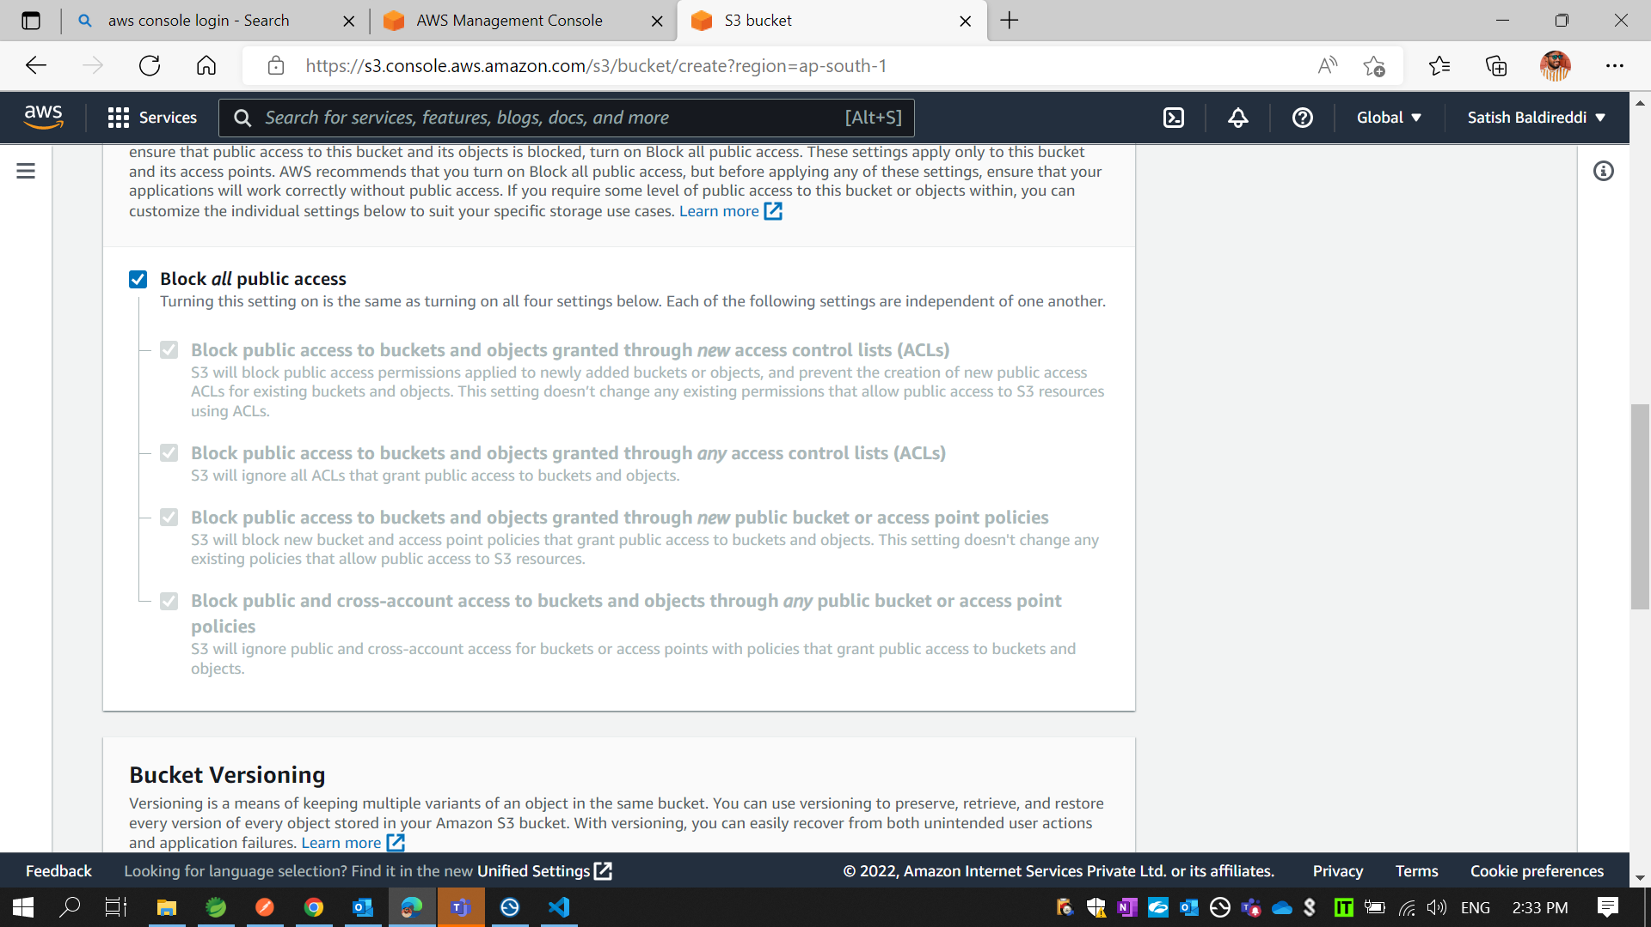
* Click on Unselect

Slide 52
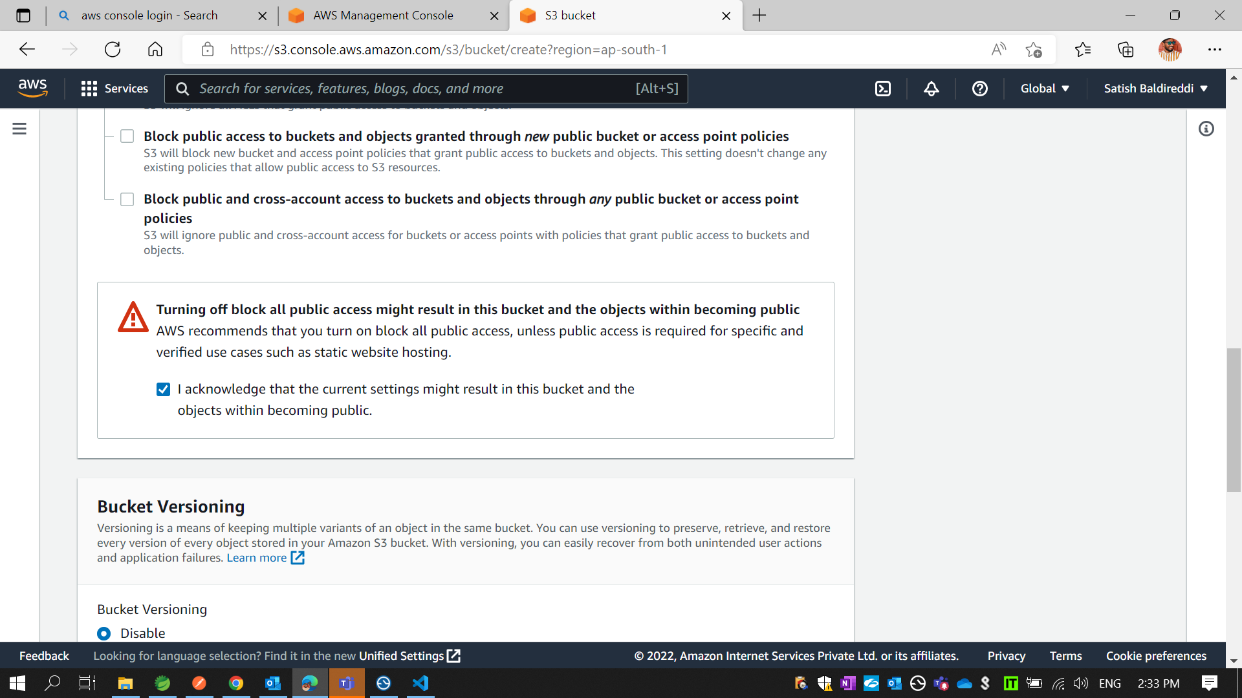
* Click on select box

Slide 53
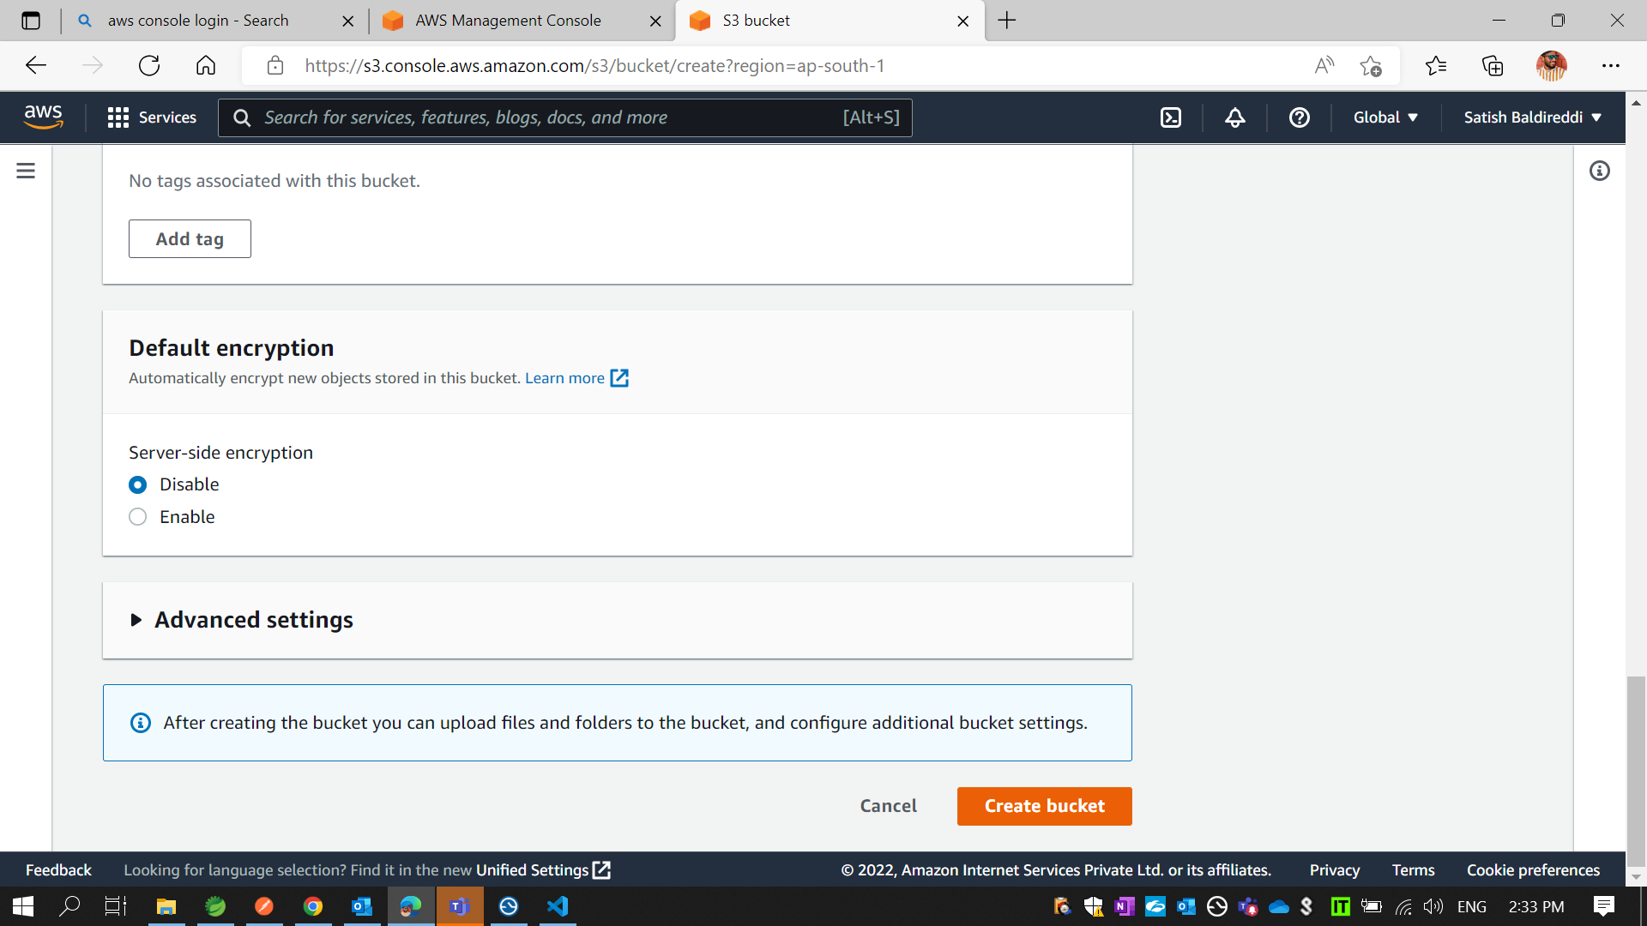
* Click on Create bucket

Slide 54

* Then Click on your bucket “dxc-forum-client”

Slide 55

* Click on Upload

Slide 56

* Click on Add Files and Add Folder

Slide 57

* Add folder

Slide 58

* Then click on Upload

Slide 59


Slide 60

* Select Properties

Slide 61

* Select Static website hosting and Click on Bucket website endpoint link

Slide 62

* Click on Permissions and Edit Bucket Policy

Slide 63

* Select Static website hosting and Click on Bucket website endpoint link

Slide 64

* Finally your front end Output Page is Displayed

Slide 65


